Slide 1
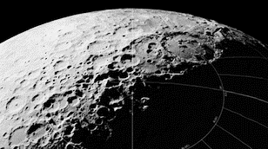
Earth Independence:
Escape
DOUG PLATA MD, MPH
President & Founder,
The Space Development Network
SpaceDevelopment.org
DevelopSpace1@gmail.com

Slide 2
Presentation Overview
What is “Earth independence”?
The two types of Earth independence?
Reasons for Earth independence
What are the elements of Earth independence?
Can Earth independence be measured?
How far can we take this?
The concept of “sufficient supply”.

Slide 3
Quarantine

Slide 4
Escape

Slide 5
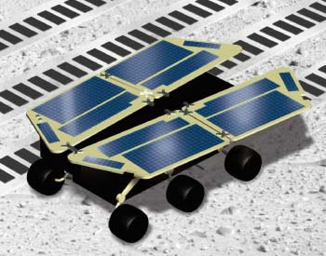
Electronics Possible?

Slide 6
Conclusions
Earth independence is the degree to which a base / colony doesn’t have to be supplied from Earth.
The ISRU areas are largely known with ideas for how they can be achieved.
High degrees of Earth independence is possible fairly early on.
Advantages are reduced costs and survival.
Complete Earth independence might be possible fairly early on.
Percent mass independence is a useful measure of Earth independence.
“Sufficient supply” can result in an earlier complete independence.

Slide 7
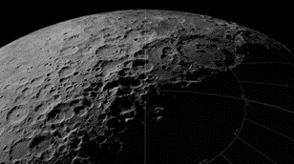
Thank you for your attention
DOUG PLATA MD, MPH
President & Founder,
The Space Development Network
SpaceDevelopment.org
DevelopSpace1@gmail.com

