Slide 1
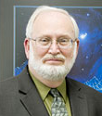
Reducing Cost by Extending Crew Stay for Missions to the Moon and Mars
Doug Plata, MD, MPH
Redlands, CA
James R. Wertz, PhD
Microcosm Inc, Torrance, CA
Anthony Shao, PhD
Microcosm Inc, Torrance, CA

Slide 2
Overview
Reducing mission cost for crewed missions.
Looking at effect of extending crew stay.
Earth Return Option (ERO).
Focus on five challenges: Sufficient supply, reliability of life support systems, radiation, insufficient gravity, certain social factors.
Radiation protection - Regolith shielding
Insufficient gravity - Tether & spin up, Indoor centrifuge. Our Gravitron experience.
Social factors – Select crew who can afford to remain away from Earth for extended periods.

Slide 3
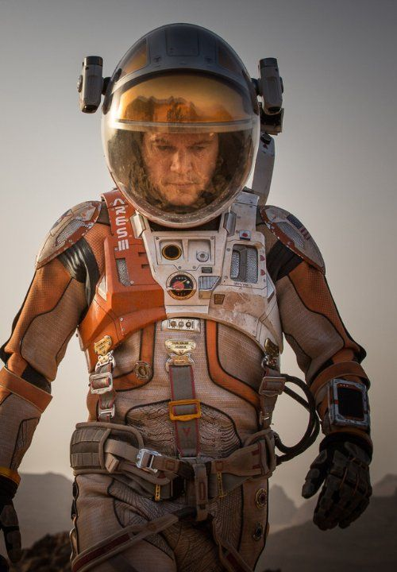
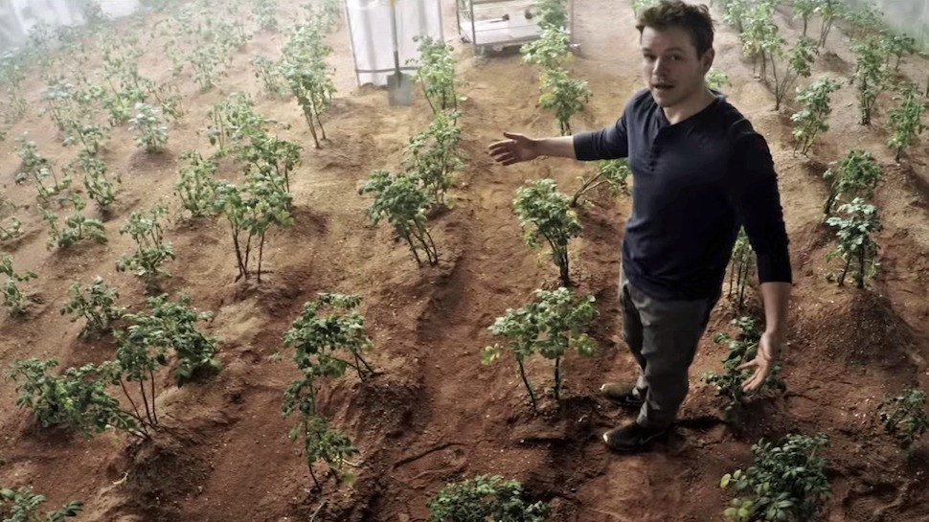
Introduction

Slide 4
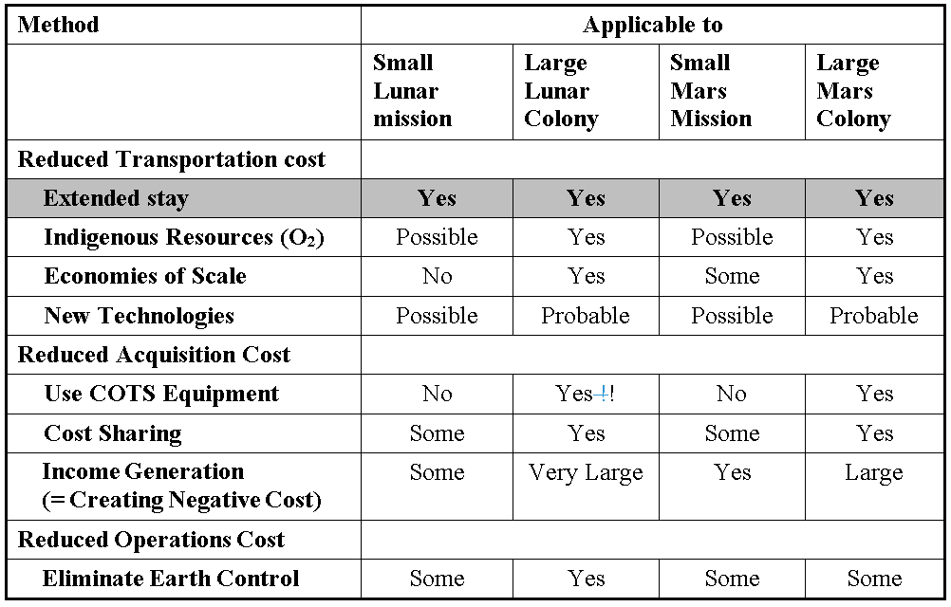
Table 1. Summary of Major Methods for Reducing Cost for Human Missions to the Moon and Mars.

Slide 5
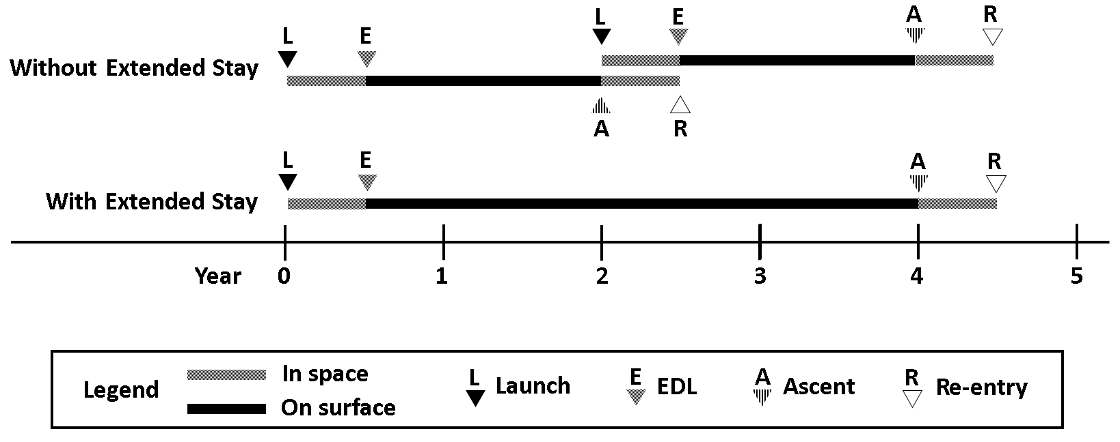
Figure 1. Comparison of in-space and surface time and crew risk events between Mars missions employing extended stay or not

Slide 6
Figure 1. Comparison of in-space and surface time and crew risk events between Mars missions employing extended stay or not

Slide 7
Figure 1. Comparison of in-space and surface time and crew risk events between Mars missions employing extended stay or not

Slide 8
Earth Return Option (ERO)
Determination whether the crew needs to return at the next Earth-return widow determined by biomedical indicators:
Radiation exposure data
BMD trend
Cardiovascular tests
VIIP changes
Blood tests
Urinalysis
Immune factors
Psychological indicators
Medical events
etc

Slide 9
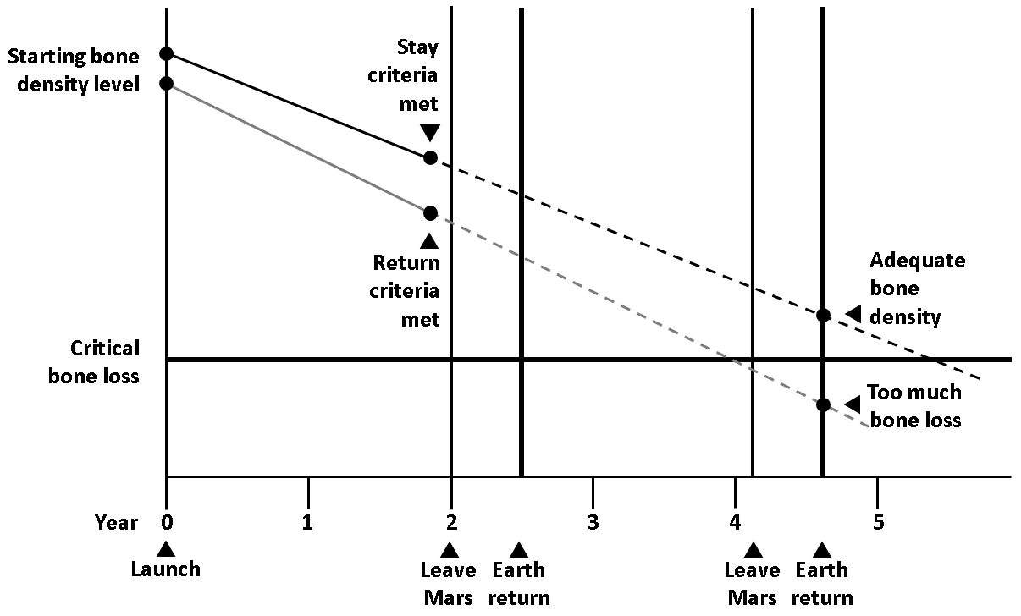
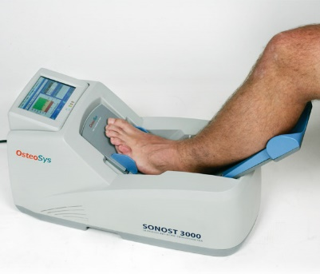
Figure 2. Illustration of bone mineral density Earth return criteria.

Slide 10
Factors Affecting Crew Stay Duration
Adequate provisions
Reliable life support systems

Slide 11
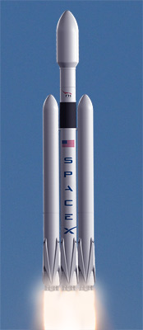
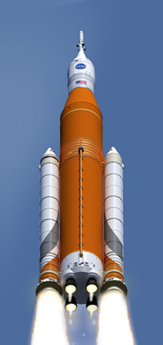
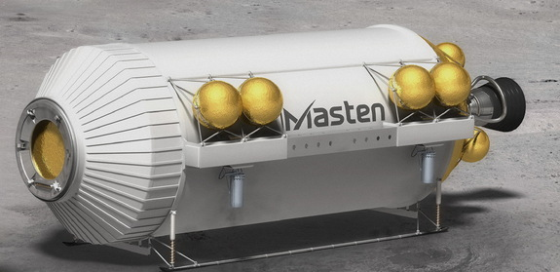
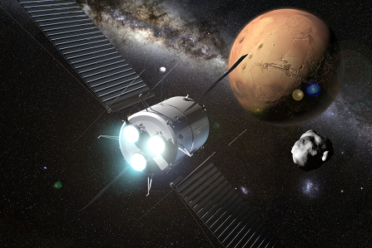
Adequate Provisions & Spare Parts

Slide 12
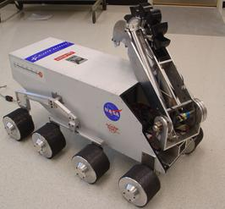
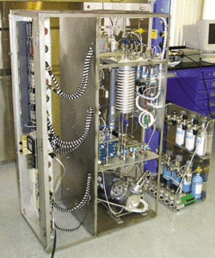
In-situ Resource Utilization

Slide 13
Factors Affecting Crew Stay Duration
Adequate provisions
Adequate spare parts
Managing radiation
Managing micro- & hypogravity

Slide 14
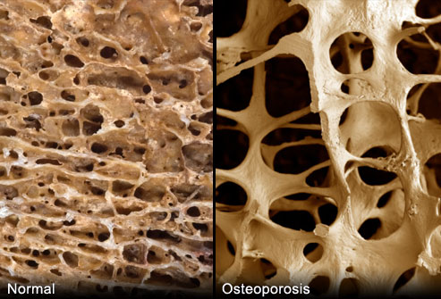
The Human Factors
Radiation
Gravity
Social

Slide 15
Space Radiation

Slide 16
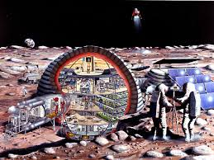
Three Types of Space Radiation

Slide 17
Spaceflight Radiation Health Program at JSC
“Storm shelters with shielding of approximately 20 g/cm2 or more of water equivalent material will provide sufficient shielding to protect the crew”
Ref: http://srag.jsc.nasa.gov/Publications/TM104782/techmemo.htm

Slide 18
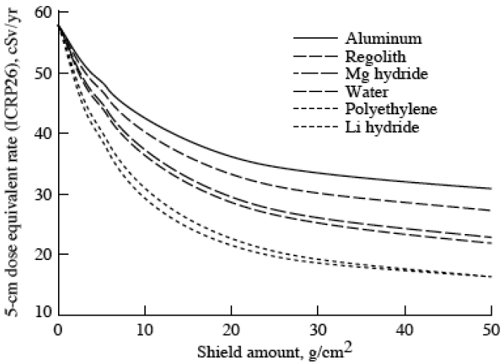
Figure 3. GCR exposure versus depth of various materials.
Simonsen et al. 1997

Slide 19
Insufficient Gravity

Slide 20
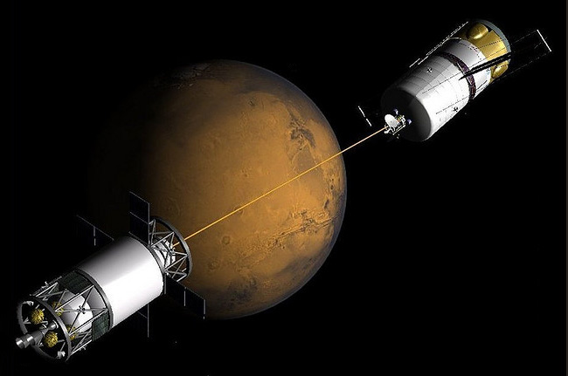
Mircogravity

Slide 21
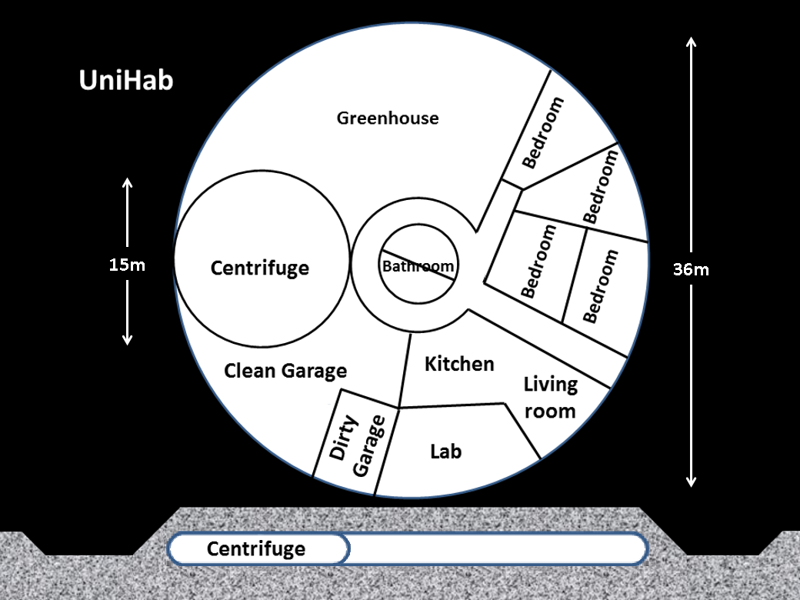
Figure 4. Simple illustration of a large inflatable habitat covered by regolith for shielding and with an indoor centrifuge.

Slide 22
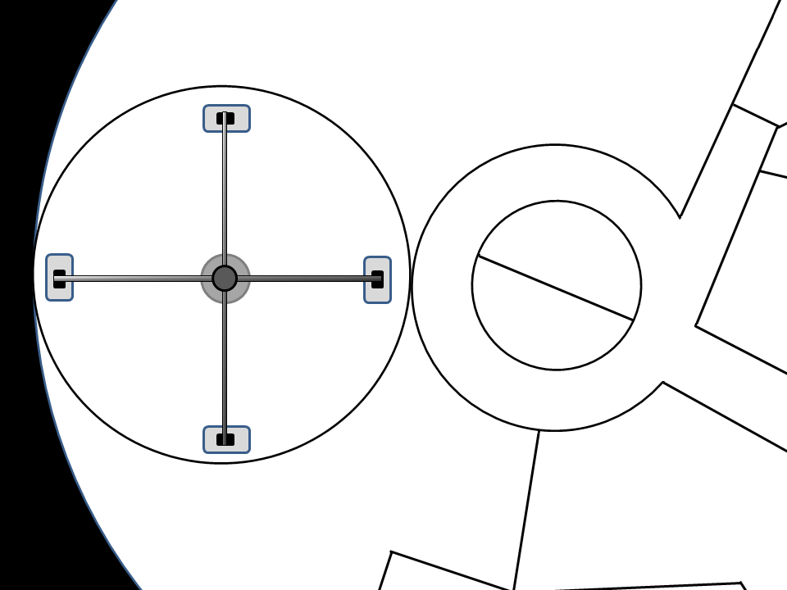
Figure 5. Illustration of a low-mass, indoor centrifuge within a shielded habitat.

Slide 23
Earth-level Hydrostatic Physiology

Slide 24
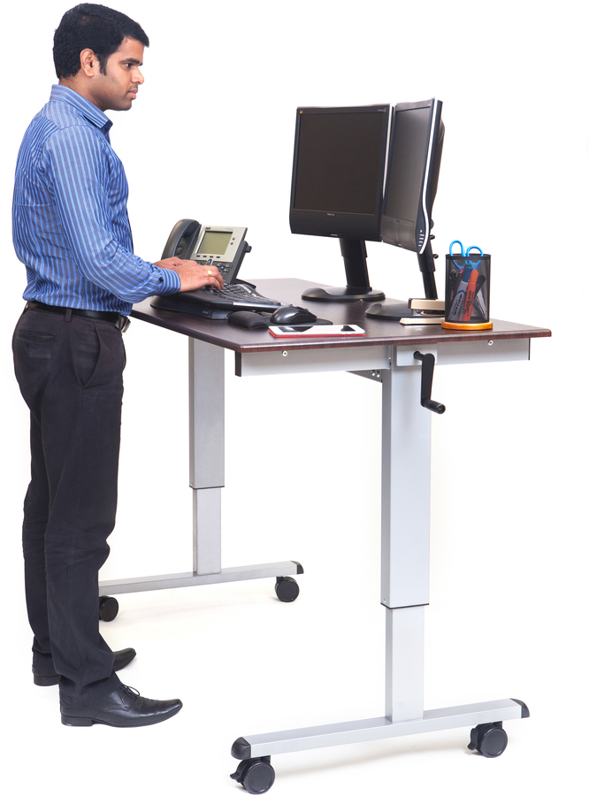
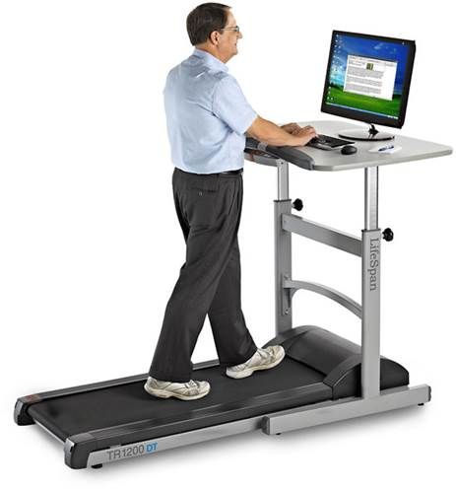
“Sedentary Activities”

Slide 25
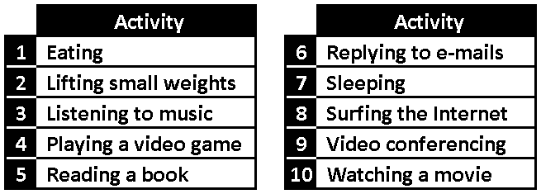
Table 2. Examples of sedentary activities able to be conducted in an 11 rpm centrifuge.

Slide 26
Figure 6. Conducting sedentary activities within a 4-meter centrifuge at 11 rpm

Slide 27
Social Factors

Slide 28
Social Factors
Parents with dependent children back on Earth.

Slide 29
Social Factors
Crew with spouses back on Earth.

Slide 30
Social Factors
Singles working and living together in confined quarters.

Slide 31
Notes:
31

Slide 32
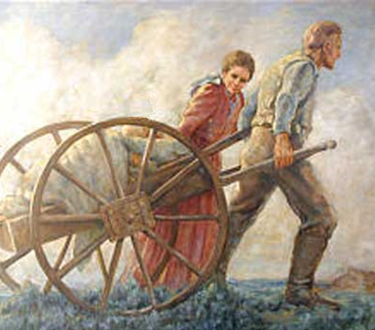
Social Factors

Slide 33
Conclusions
There are a number of opportunities unique to crewed missions to reduce overall mission costs. We have focused upon five approaches which would allow for extending crew stay. These include: sufficient supplies, reliability of life support systems, radiation protection, rotational gravity, and ensuring that the initial crew’s social status is compatible with extended stays. It appears that there may be readily available strategies to address these five factors. Extending crew stay would reduce crew rotation costs, reduce the risk of crew loss, and so set the stage for establishing a permanent off-Earth base.

Slide 34
Thank you for your attention

Slide 35
Image References
Slide 3 (The Martian) – http://www.comicbookmovie.com/sci-fi/20th-century-fox-officially-announces-the-martian-extended-edition-blu-ray-a141164
Slide 3 (The Martian potatoes) - http://www.techinsider.io/growing-food-on-mars-like-the-martian-2015-9
Slide 9 (Ankle BMD) - http://www.mar-med.pl/produkt/sonost3000
Slide 11 (Falcon Heavy) - http://space.skyrocket.de/doc_lau_det/
falcon-9-heavy.htm
Slide 11 (Food box) - http://www.nourishnc.org/donate/food-boxes/nourish-a-child-for-the-weekend/
Slide 11 (Ion propulsion) - http://ccar.colorado.edu/asen5050/projects/projects_2015/Students/Matheson_Ryan/
Slide 12 (Ice harvester) - http://www.thelivingmoon.com/41pegasus
/01archives/Bucket_Excavator_01.htm
Slide 12 (ISRU hardware) - http://www.forum-conquete-spatiale.fr/t15276-nouvelle-etude-nasa-pour-le-voyage-habite-vers-mars
Slide 14 (Osteoporosis) - http://www.deilataylor.com/phytoestrogens-and-bones/
Slide 14 (Space radiation) - https://www.inprnt.com/gallery/ghoste
/bodies-in-space-radiation/
Slide 14 (Couple1) - http://www.vietgiaitri.com/chuyen-yeu/tam-su/2016/04/toi-da-co-mot-dem-tinh-yeu-toi-te-nhat-trong-cuoc-doi/
Slide 16 (Eclipse) - http://www.la.lv/1962-gada-27-augusta-2/
Slide 16 (GCR) - http://www.space.com/16832-cosmic-rays-discovery-100-years.html
Slide 16 (Orion) - http://www.dailymail.co.uk/sciencetech/article-2172434/Another-small-step-Nasa-unveils-Orion-capsule-bound-astronauts-Mars.html
Slide 16 (Shelter) - http://pics-about-space.com/astronaut-working-on-space-station?p=3
Slide 16 (Solar flare) - http://gde.md/news/nauka/2402-gigantskaya-vspyshka-na-solnce-mozhet-unichtozhit-vse-zhivoe-na-zemle.html
Slide 20 (Tether) - http://tinyurl.com/jmtlyyeSlide 24 (Computer stand) - https://www.walmart.com/ip/Luxor-59-W-Crank-Adjustable-Stand-Up-Desk-Dark-Walnut/43233116
Slide 24 (Treadmill) - http://desk.vernonhillsboutique.com/how-to-build-your-own-treadmill-desk/treadmill-desk-design/
Slide 28 (Mother & child) - http://www.fwpeds.com/vomiting-diarrhea
Slide 29 (Couple2) - https://twitter.com/morrisonmoving/status/764106680116375553
Slide 30 (Love triangle) - https://chicasdelbarrio.wordpress.com/tag/
taylor-lautner/
Slide 31 (Biologist) - http://smithfieldpd.com/category/events/page/2/
Slide 31 (Chemist) - http://www.marist.edu/academics/scholarships/
Slide 31 (Engineer) - http://www.bands.af.mil/photos/mediagallery.asp
?galleryID=842&?id=-1&page=18&count=24
Slide 31 (Machinist) - http://www.madsmith.com/field-services
Slide 31 (Physician) - http://faleieaindafaleipouco.blogs.sapo.pt
/2014/04/
Slide 31 (Roboticist) - http://www.asianscientist.com/2012/11/features/the-mystery-of-the-missing-women-scientists-2012/
Slide 32 (Settlers) - http://www.dreamfield.farm/blog
Slide 34 (Cat) - http://rockntech.com.br/28-gatos-que-definitivamente-dominam-a-arte-de-ficar-em-pe/2/

Slide 36
Literature References
Criswell, Marvin E., and Jenine E. Abarbanel. 1997. "In situ resource utilization for support of a lunar base." 36th AIAA Aerospace Sciences Meeting and Exhibit. 1997.
Eckart, Peter J. 1996. Parametric Model of a Lunar Base for Mass and Cost Estimates (Ph.D. dissertation), Technical University of Munich, Germany.
Hassler, Donald M., et al. 2014. "Mars’ surface radiation environment measured with the Mars Science Laboratory’s Curiosity rover." science 343.6169 (2014): 1244797.
Pittman, R. B., L. Harper, M. Newfield, D. Rasky, 2014. Lunar Station: The Next Logical Step in Space Development, 65th International Astronautical Congress, Sep-Oct, 2014
Sargusingh, Miriam J., and Jason R. Nelson. 2014. "Environmental control and life support system reliability for long-duration missions beyond lower earth orbit." 44th International Conference on Environmental Systems.
Simonsen, L. C., W. Schimmerling, J. W. Wilson, and S. A. Thibeault. 1997. "Construction Technologies For Lunar Base: Prefabricated Versus In Situ," in "Shielding Strategies for Human Space Exploration," Edited by J. W. Wilson, J. Miller, A. Konradi, and F. A. Cucinotta. NASA Conference Publication 3360. NASA3360.pdf
Townsend, L.W., et al. 1992. "Human Exposure to Large Solar Particle Events in Space", Advances in Space Research, Volume 12, Issues 2–3, pp. 339-348.
Wertz, J.R., et al., 2016. "Methods for Reducing Cost for Human Missions to the Moon and Mars," in preparation.
Young, L. R. 1999. Artificial Gravity Considerations for a Mars Exploration Mission. Annals of the New York Academy of Sciences, 871: 367–378. doi:10.1111/j.1749-6632.1999.tb09198.
Zeitlin, C., et al. "Measurements of energetic particle radiation in transit to Mars on the Mars Science Laboratory." Science 340.6136 (2013): 1080-1084.

