Slide 1
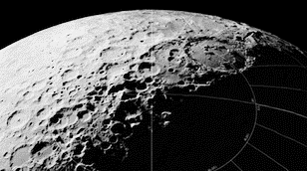
Five Phases of Lunar Development
DOUG PLATA MD, MPH
President & Founder,
The Space Development Network
SpaceDevelopment.org
DevelopSpace1@gmail.com

Slide 2
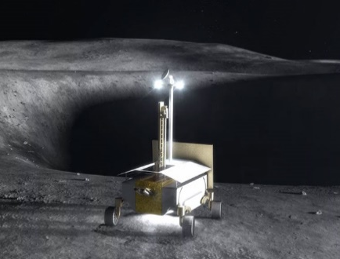
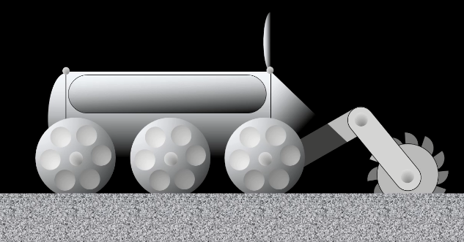
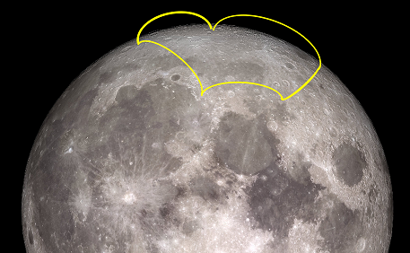
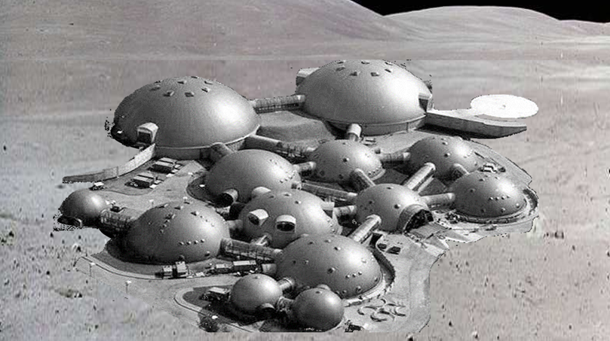
Five Phases of Lunar Development
1. Prospecting
2. Telerobotic
3. Initial crewed
4. International, suborbital, lunar exploration
5. Private settlement
Notes:
2

Slide 3
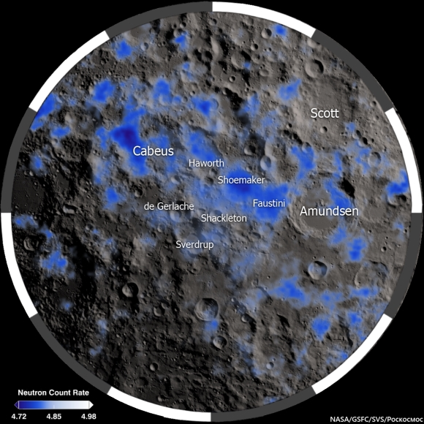
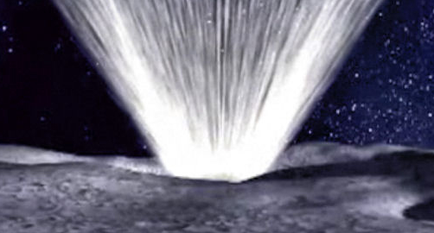
Lunar Polar Ice
“Given the estimated total excavated mass of regolith that reached sunlight, and hence was observable, the concentration of water ice in the regolith at the LCROSS impact site is estimated to be 5.6 ± 2.9% by mass”.
A. Colaprete, et al. "Detection of Water in the LCROSS Ejecta Plume", Science 22 Oct 2010: Vol. 330, Issue 6003, pp. 463-468.
Hydrogen concentration (NASA)
From LCROSS animation (NASA)
Notes:
3

Slide 4
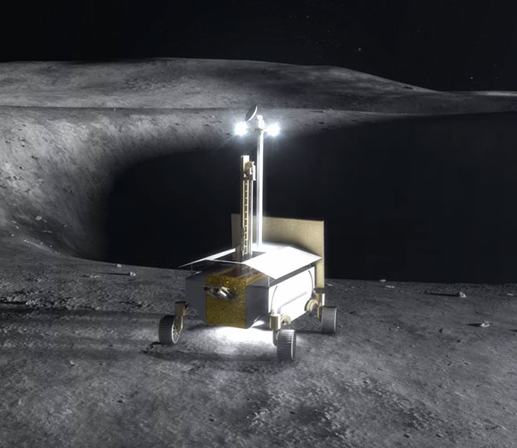
1. Prospecting Phase
“RP will provide knowledge to inform the selection of future destination, support the development of exploration systems, and reduce the risks associated with human exploration”.
D. R. Andrews, et al. "Introducing the Resource Prospector (RP) Mission", AIAA SPACE 2014 Conference and Exposition, AIAA SPACE Forum, (AIAA 2014-4378).
Resource Prospector mission (NASA)
Notes:
4

Slide 5
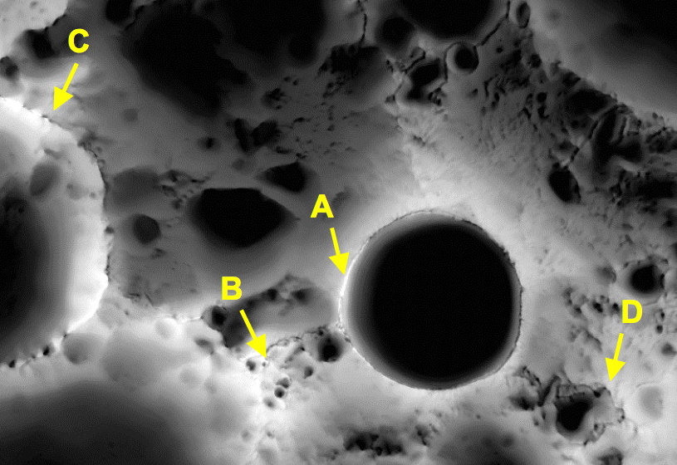
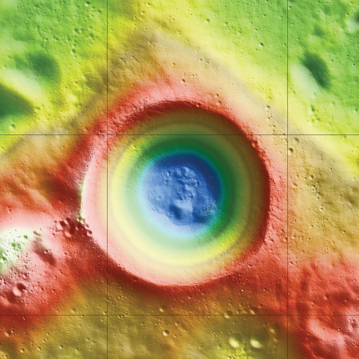
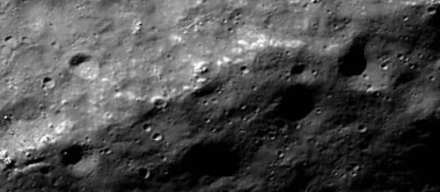
1. Prospecting Phase
Concept for traverse path between sunlit peaks
Shackleton Crater (NASA – LRO)
Rim of Shackleton Crater south pole (NASA – LRO)
Notes:
5

Slide 6
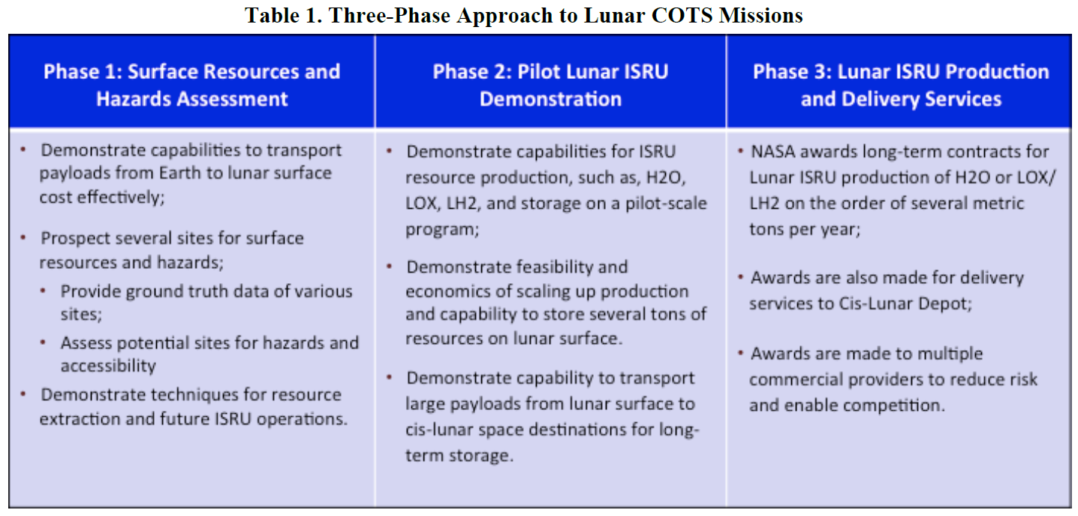
1. Prospecting Phase
Zuniga, et al, AIAA 2016

Slide 7
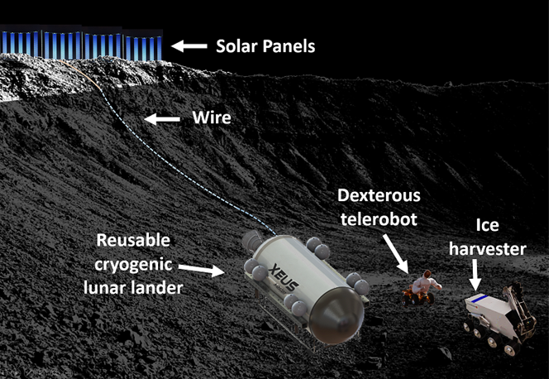
2. Telerobotic Phase
Concept for an initial ice-harvesting operation

Slide 8
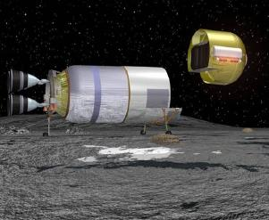
2. Telerobotic Phase
XEUS lander – crew (ULA)
Concept for an Ice Harvester
Notes:
8

Slide 9
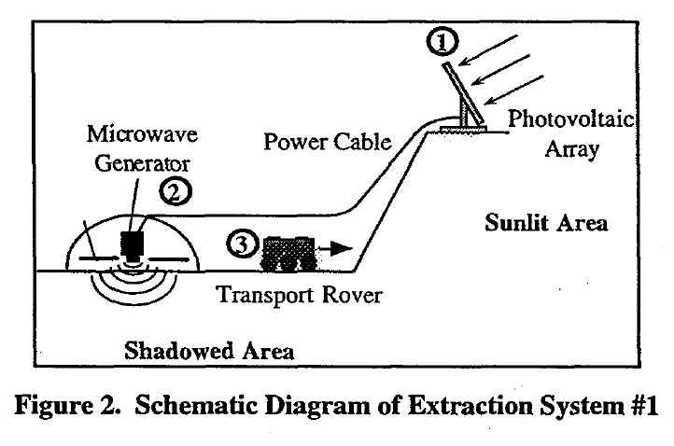
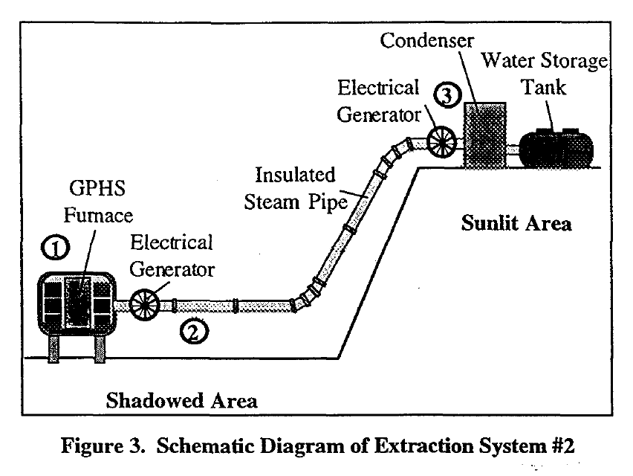
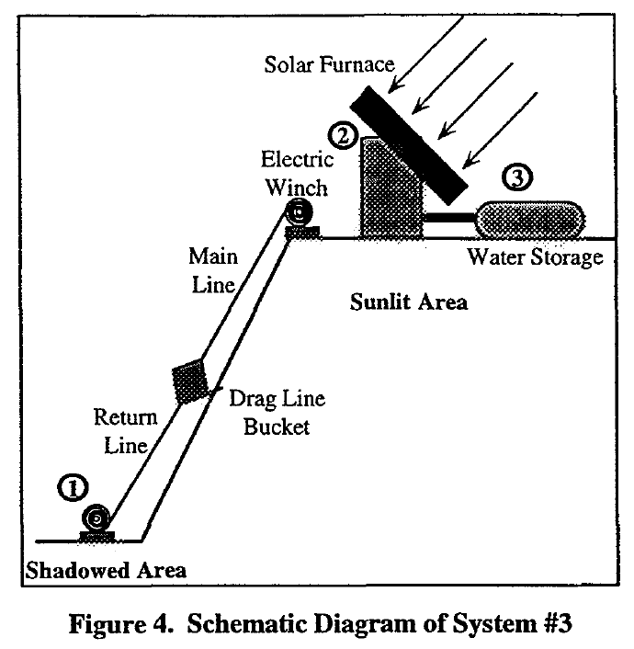
2. Telerobotic Phase
Duke, et al, AIAA 1998
Notes:
9

Slide 10
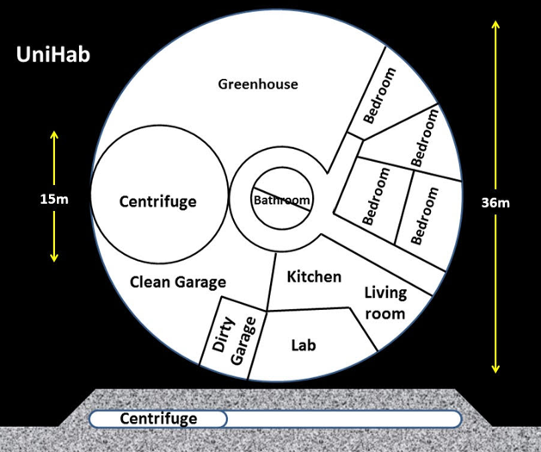
3. Initial Crew Phase
UniHab concept (Plata)
Concept of an initial, permanent, lunar crew and their jobs

Slide 11
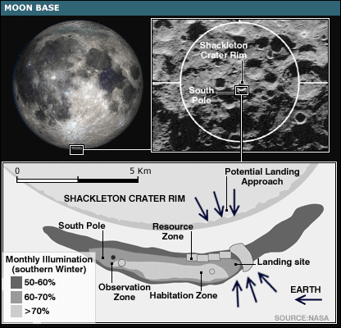
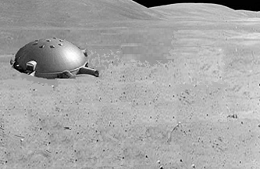
3. Initial Crew Phase
Shackleton base concept (NASA)
Notion of an initial lunar base

Slide 12
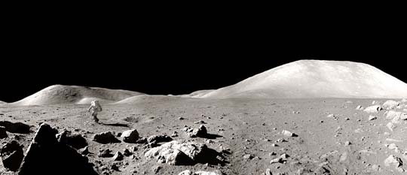
3. Initial Crew Phase
Lunar base concept – Bird’s eye view
Lunar base concept – Surface view

Slide 13
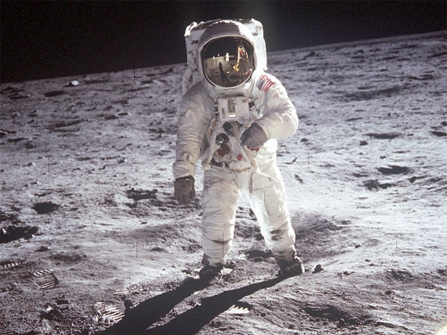
4. International, Suborbital, Lunar Exploration Phase
Lunar astronaut (NASA)
Suborbital lunar exploration

Slide 14
5. Private Settlement Phase
Illustration of a lunar base adapted from Radio Muzyka Fakty (Poland)

Slide 15
Financing
Phase 1 - NASA - Prospecting
Phase 2 - PPP - Vehicle & telerobotic development
Phase 2 - PPP - Lunar surface transport & operations
Phase 3 - PPP - Commercial crew
Phase 4 - Intl - Intl suborbital exploration
Phase 5 - Savings - Private settlement

Slide 16
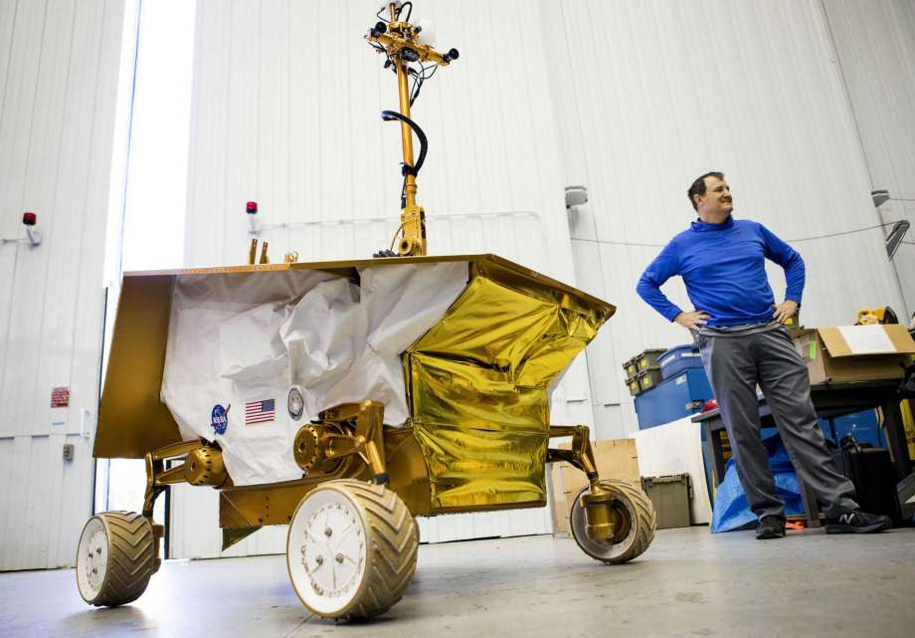
Financing: Prospecting Phase
Resource Prospector mission video (NASA)
Resource test article (NASA)

Slide 17
Financing: Lunar COTS (LCOTS)
NASA’s Budget:
NASA’s Budget:
3-5%
5-7%
COTS-CC-CC
“Lunar COTS”

Slide 18
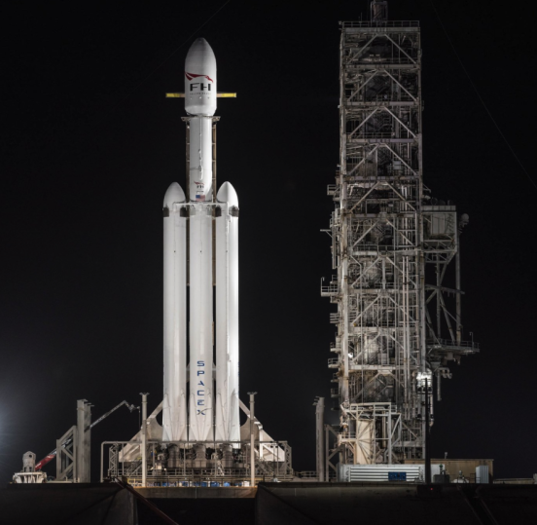
Financing: Lunar COTS (LCOTS)
Falcon Heavy (SpaceX)
ACES lander (ULA)

Slide 19
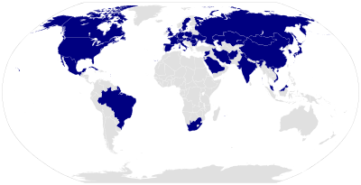
Financing: International, Suborbital, Lunar Exploration
Suborbital lunar hops
Countries of astronauts (Wikipedia – AstroFreak92)

Slide 20
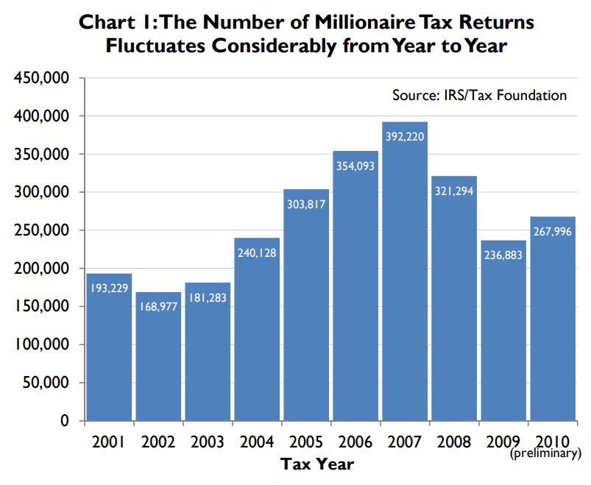
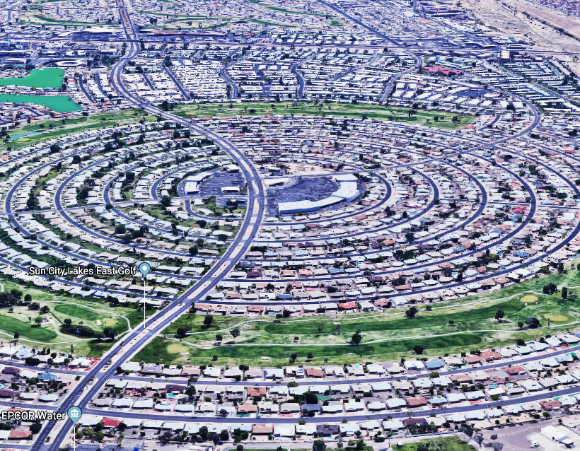
Financing: Private Settlement
(IRS – Tax Foundation)
Sun City, Phoenix, AZ (Google Maps)

Slide 21
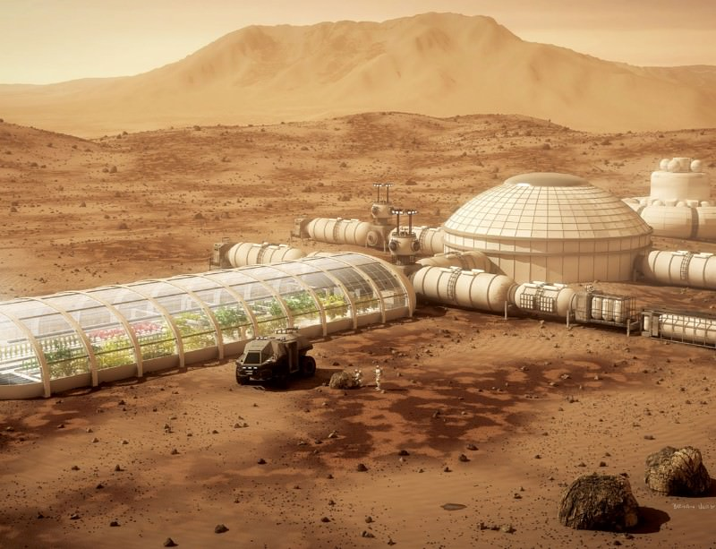
Beyond the Moon
Illustration of a lunar base adapted from Radio Muzyka Fakty (Poland)
Credit: Bryan Versteeg

Slide 22
Summary
Phases Funding
1. Prospecting
1. NASA
2. Telerobotic
2. Lunar COTS
3. Initial crewed
3. Lunar COTS
4. International, suborbital, lunar exploration
4. Sovereign clients
5. Private settlement
5. Savings

Slide 23
References
A. Colaprete, et al. "Detection of Water in the LCROSS Ejecta Plume", Science 22 Oct 2010: Vol. 330, Issue 6003, pp. 463-468.
A. F. Zuniga, et al. "Kickstarting a New Era of Lunar Industrialization via Campaigns of Lunar COTS Missions", AIAA SPACE 2016, AIAA SPACE Forum, (AIAA 2016-5220)
D. R. Andrews, et al. "Introducing the Resource Prospector (RP) Mission", AIAA SPACE 2014 Conference and Exposition, AIAA SPACE Forum, (AIAA 2014-4378)
M. Duke, et al. "Mining of Lunar polar ice", 36th AIAA Aerospace Sciences Meeting and Exhibit, Aerospace Sciences Meetings, https://doi.org/10.2514/6.1998-1069
L. Purves. "Use of Lunar Outpost for Developing Space Settlement Technologies", AIAA SPACE 2008 Conference & Exposition, AIAA SPACE Forum, https://doi.org/10.2514/6.2008-7680

