Slide 1
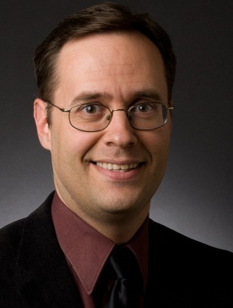
Comparing Lunar & Martian Greenhouses
DOUG PLATA MD, MPH
Space Development Network
DevelopSpace.info
DougSpace007@gmail.com
909-557-7483

Slide 2
Overview
Notes:
2

Slide 3
Overview
How the debate got started
Is sunlight the deciding issue?
Specifying greenhouse designs
Identifying the relevant factors
Comparing the relevant factors
The ideal Martian greenhouse
l
l
l
l
l
l
Notes:
3

Slide 4
The Debate
Notes:
4

Slide 5
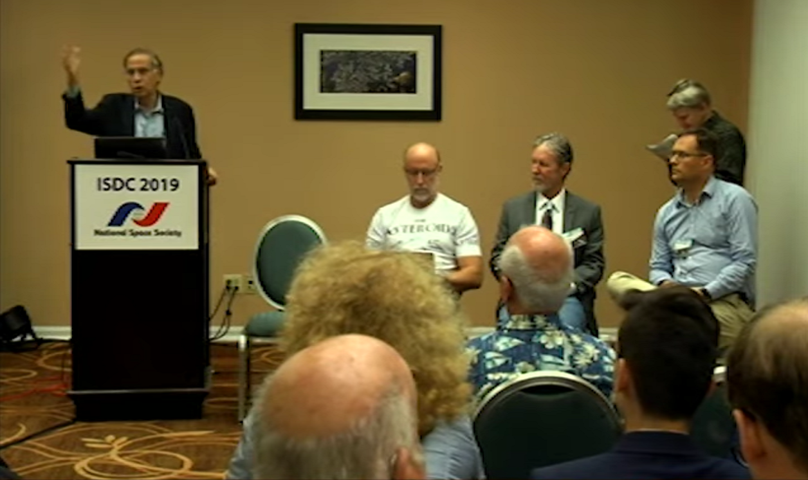
The Debate

Slide 6
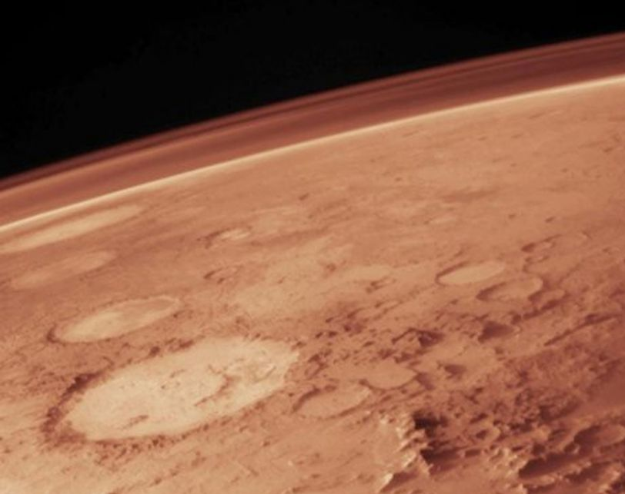
The Debate
Thick enough atmosphere
Protects from SPEs
No shielding needed
Direct sunlight
No need for solar arrays
l
l
l
l
l

Slide 7
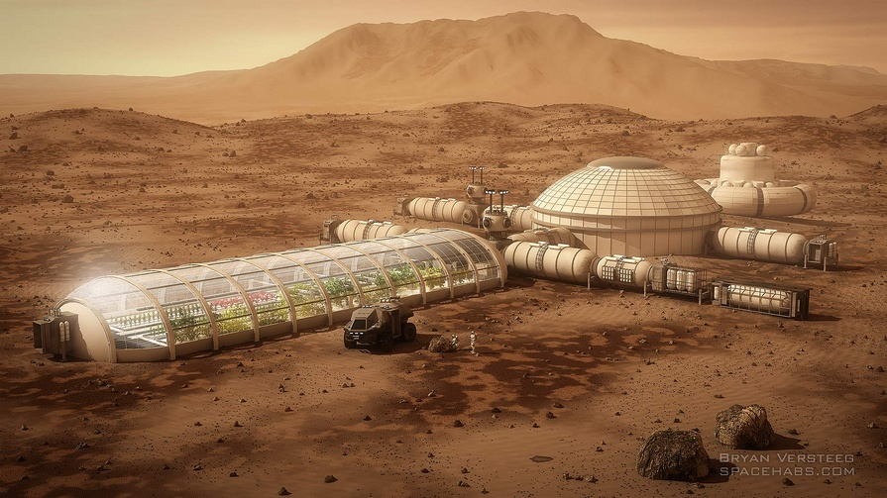
The Debate

Slide 8
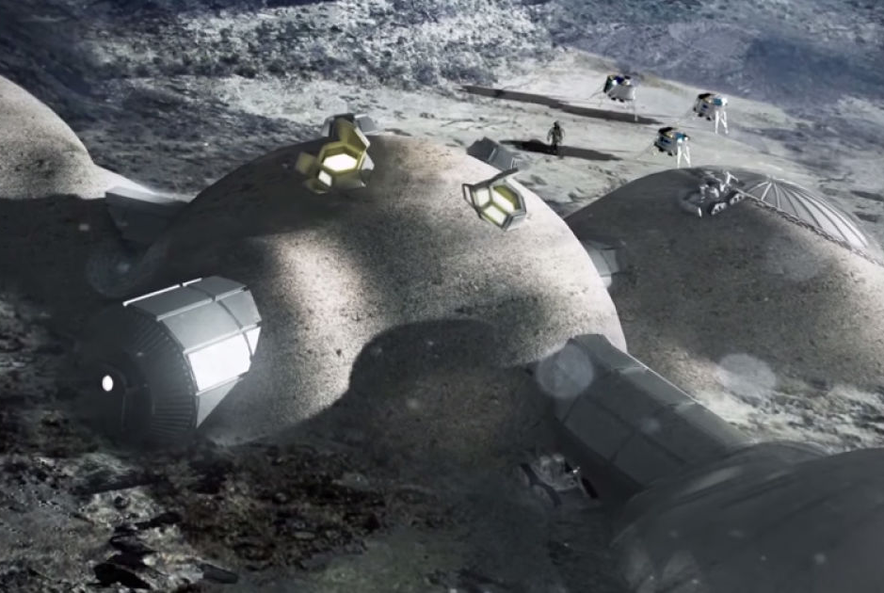
The Debate

Slide 9
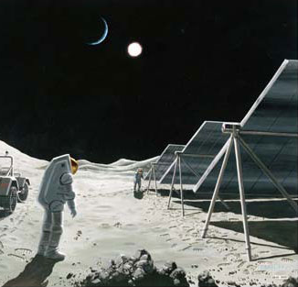
The Debate

Slide 10
Solar Panels
l
l
Payload mass
Energy conversion losses

Slide 11
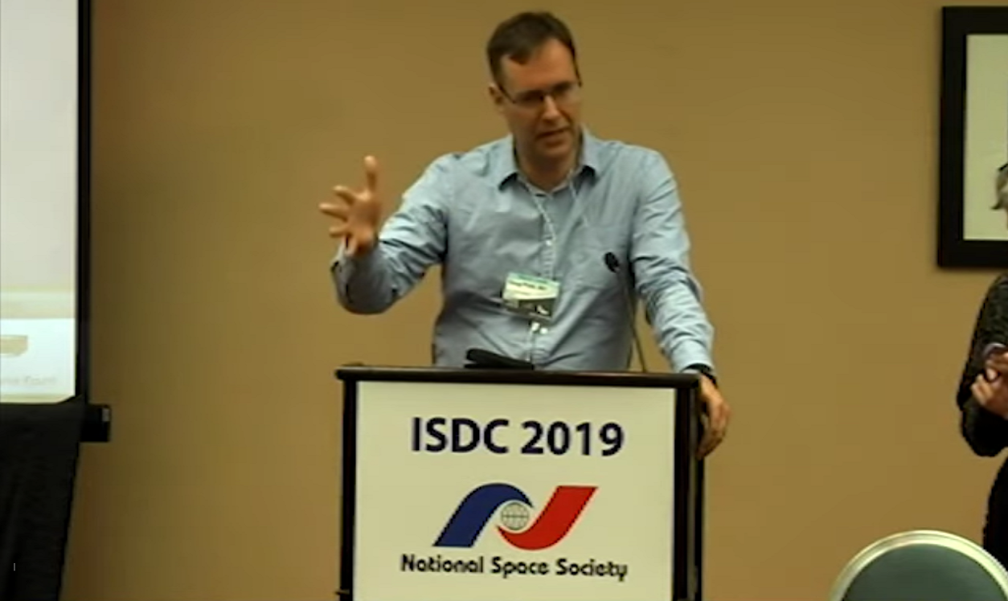
Analysis

Slide 12
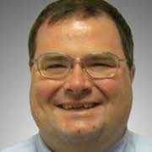
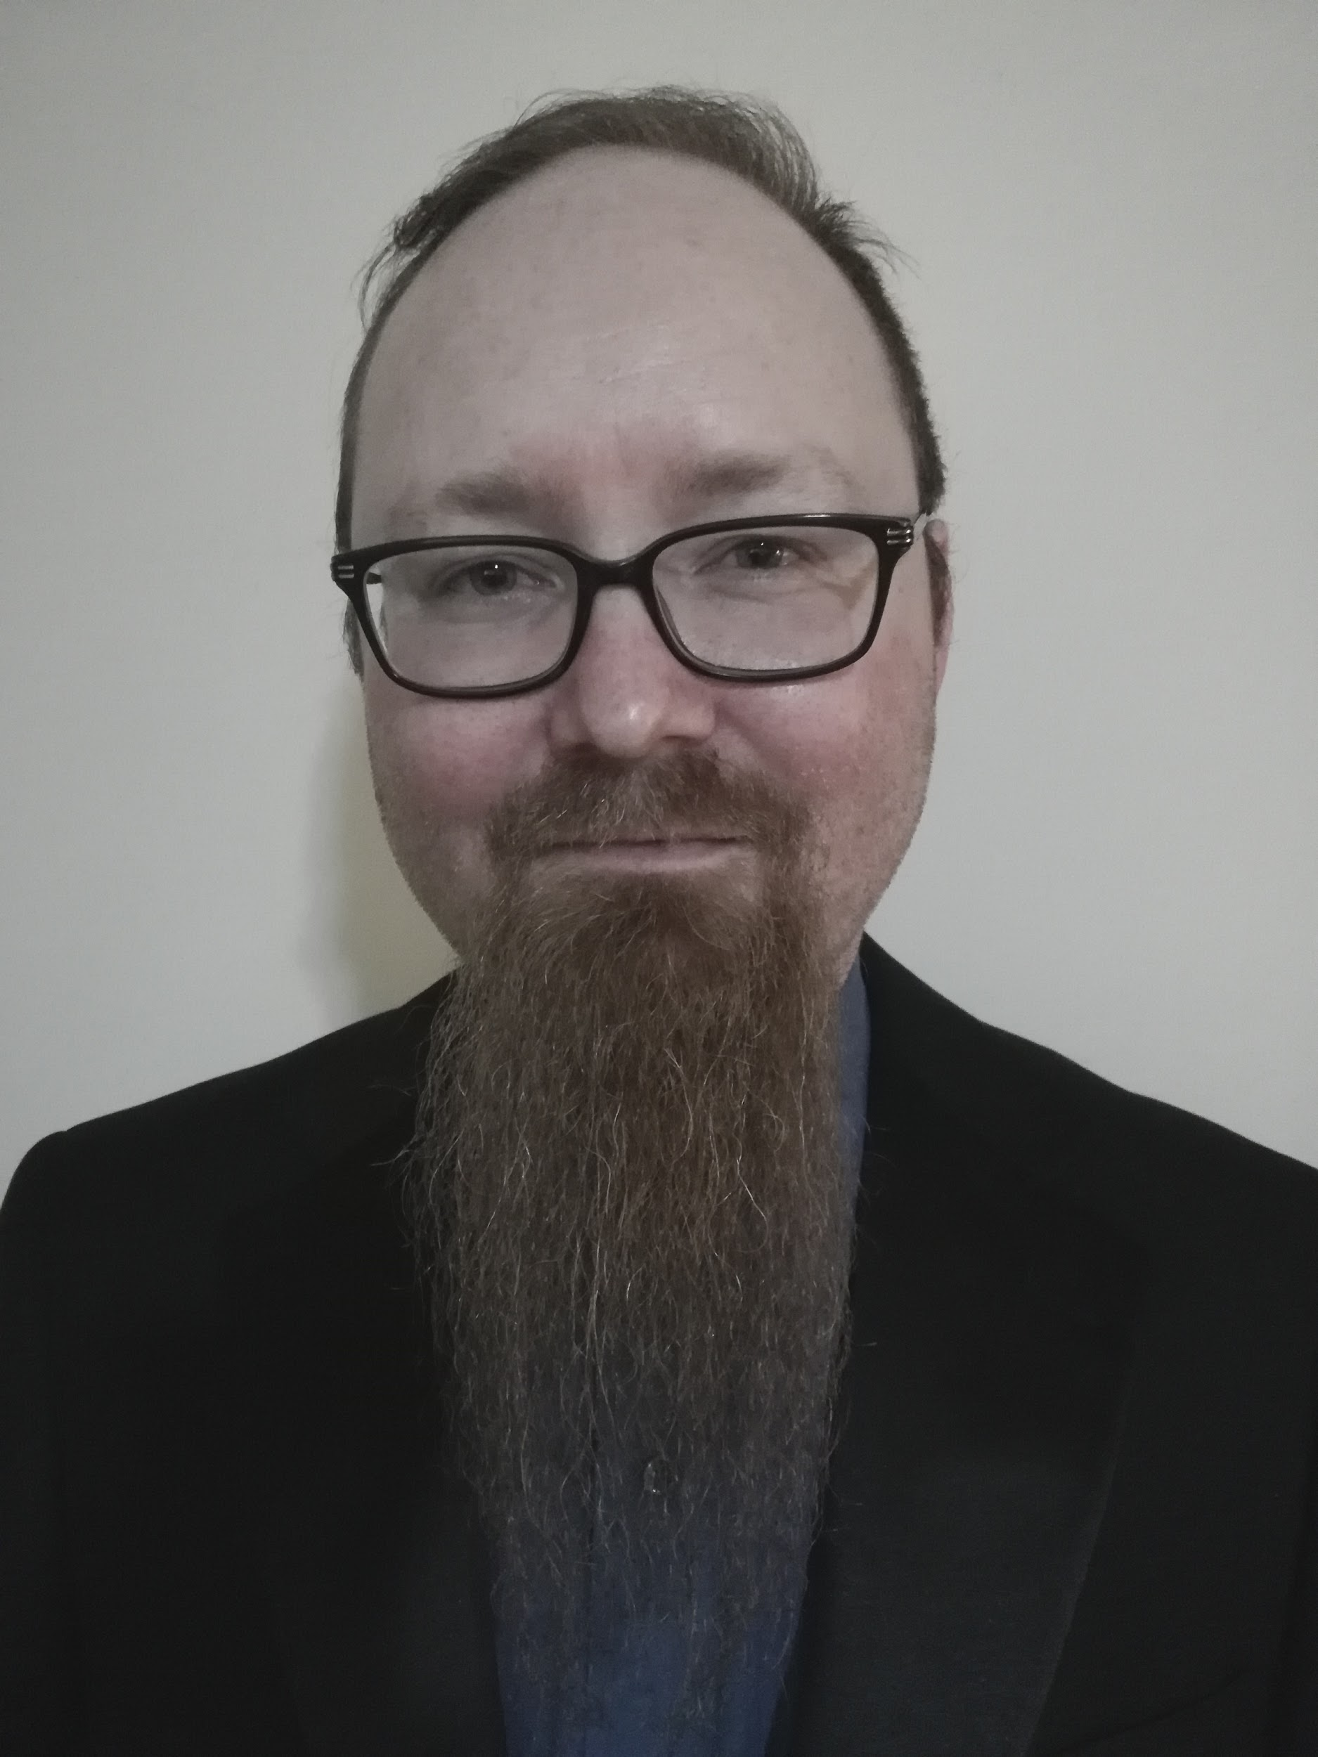
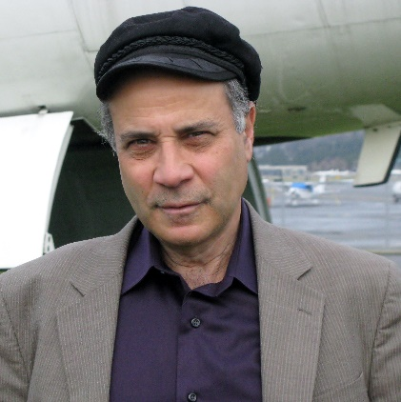
Analysis

Slide 13
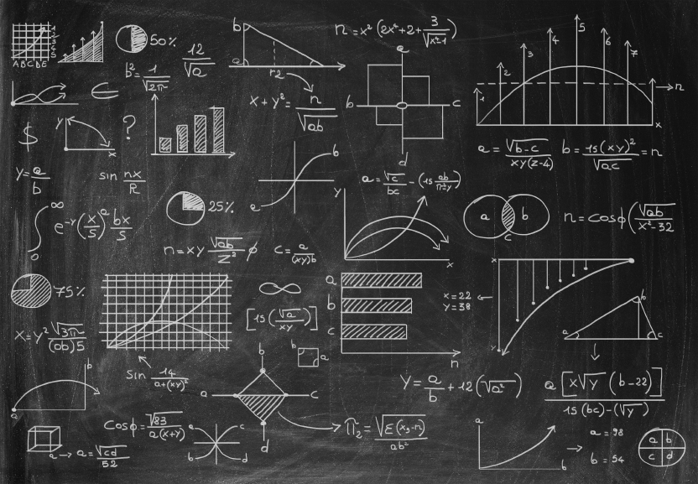
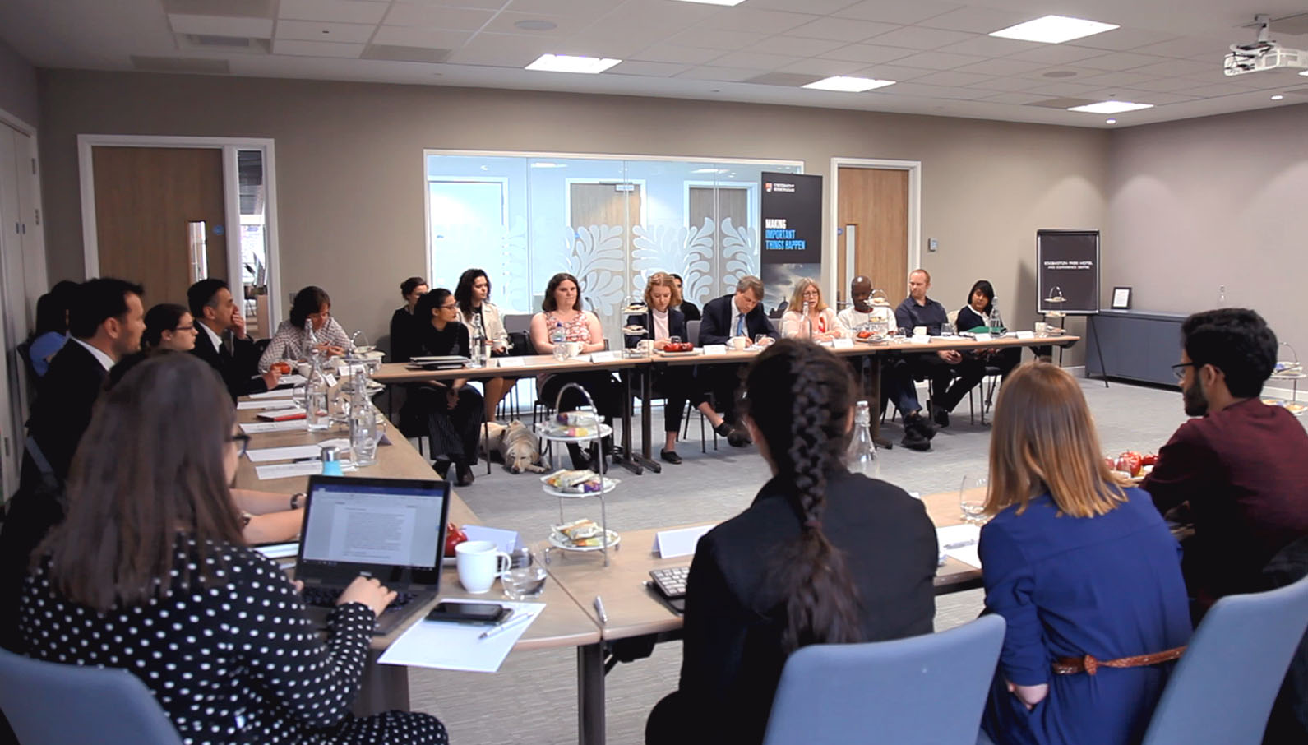
Complex

Slide 14
Other Factors

Slide 15
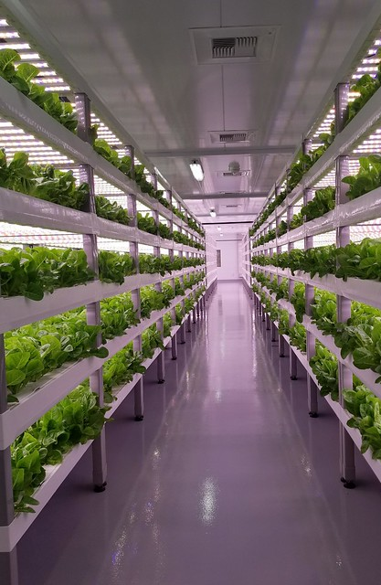
Other Factors

Slide 16
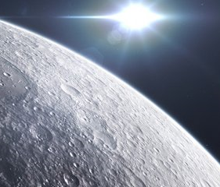
Other Factors

Slide 17
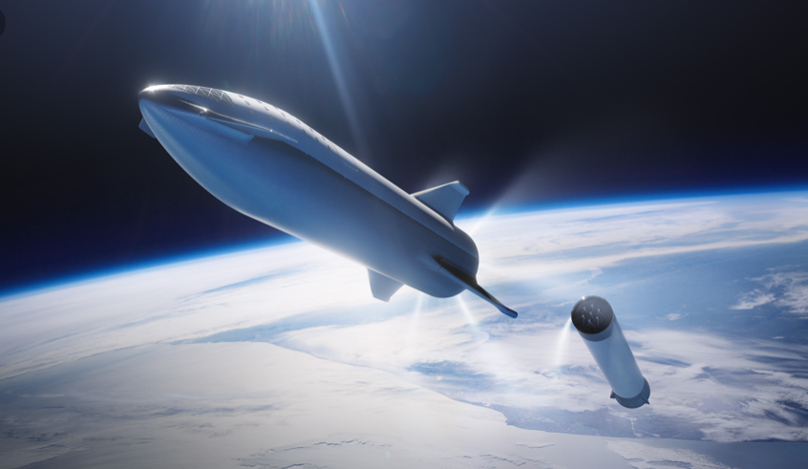
Other Factors

Slide 18
Two Questions
l
l
What is the better location?
What is the optimal choice for a Martian greenhouse?

Slide 19
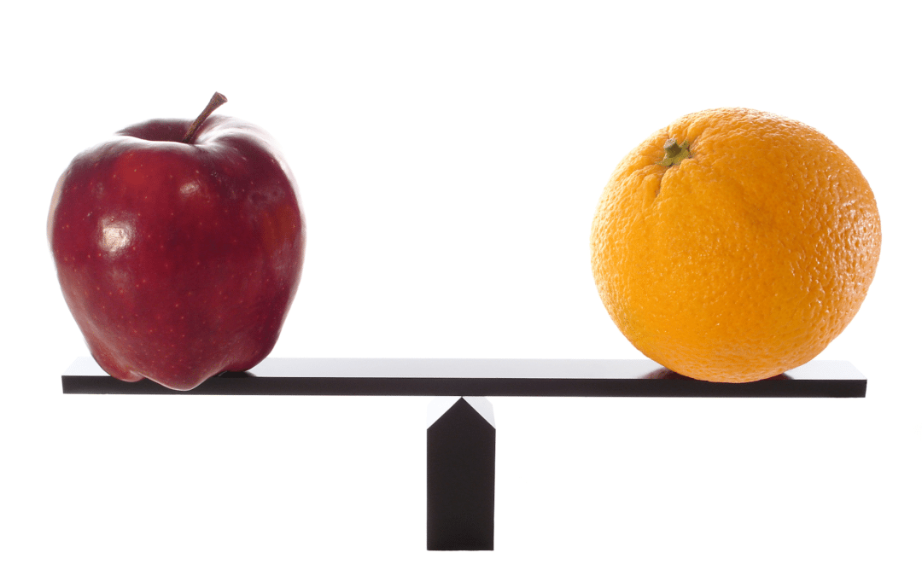
Fair Comparison

Slide 20
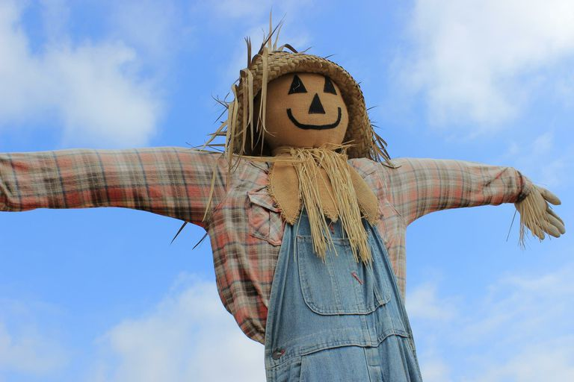
Compare What?
What are the proposed designs of the lunar and Martian greenhouses that we are going to compare?

Slide 21
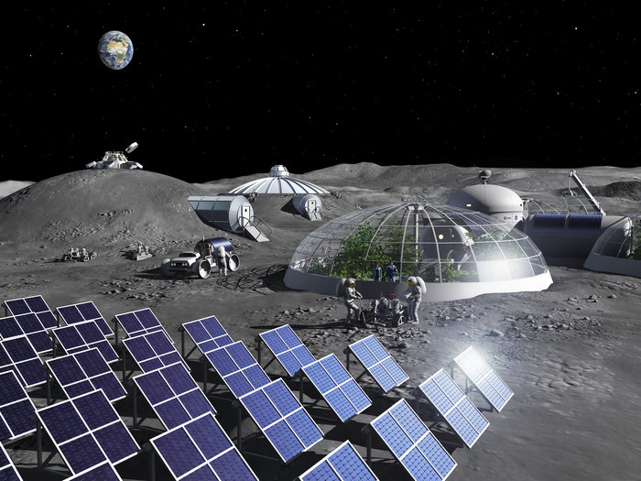
Compare What?

Slide 22
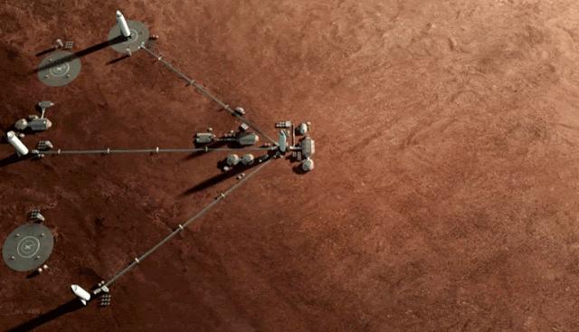
Compare What?

Slide 24
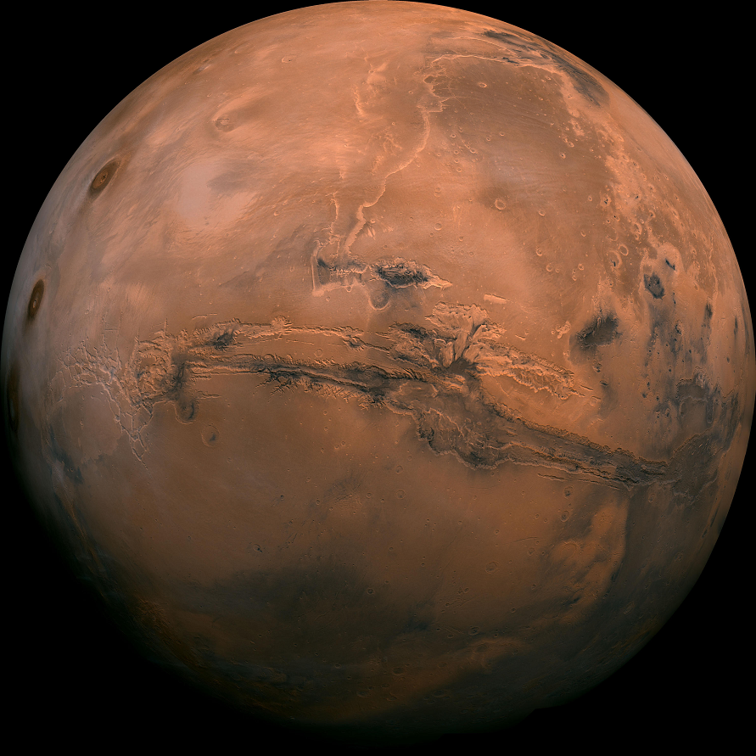
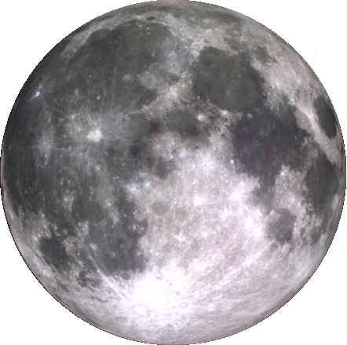
Compare What?

Slide 25
The Notional Greenhouses
Notes:
25

Slide 29
Relevant Factors
 | MOON | MARS
Location | Poles (PELs) | Equatorial
Volume | 20m x 20m x 3m | 36m x 36m x 1m
Design | Pancake-shaped | Quonset hut
Materials | Metals from regolith | Plastics from air
Shielding | Regolith covering | Nothing
Plant / Harvest | By crew in greenhouse | Trays transported
Maintenance | By crew in greenhouse | Trays transported

Slide 34
Relevant Factors
 | MOON | MARS
Lighting | Magenta LEDs | Direct sunlight
Power source | ISRU PV cells | Sun
Sunlight | 90% of day = 1,240 W | 50% - 15% = 250 W
Conversion losses | 15% efficient | 100%
Plant configuration | 3D | 2D
Substrate | Hydroponic | Hydroponic

Slide 35
Comparing Apples
MARS
No PV needed | 1.20x
CO2 available | 1.05x
N2 available | 1.05x
Plastic available | 3.00x
No regolith needed | 1.10x
Conversion losses | 5.00x

Slide 36
Comparing Apples
MARS
No PV needed | 1.20x
CO2 available | 1.05x
N2 available | 1.05x
Plastic available | 3.00x
No regolith needed | 1.10x
Conversion losses | 5.00x
MOON
3D volume | 3.00x
Solar intensity | 2.00x
Magenta LEDs | 1.33x
Daylight | 2.25x
Teleoperations | 2.00x

Slide 37
Comparing Apples
MARS
No PV needed | 1.20x
CO2 available | 1.05x
N2 available | 1.05x
Plastic available | 3.00x
No regolith needed | 1.10x
Conversion losses | 5.00x
MOON
3D volume | 3.00x
Solar intensity | 2.00x
Magenta LEDs | 1.33x
Daylight | 2.25x
Teleoperations | 2.00x
Quicker roundtrips | 79x

Slide 38
Better Greenhouses
Notes:
38

Slide 40
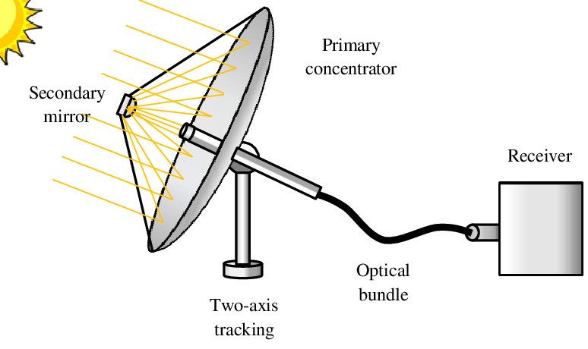
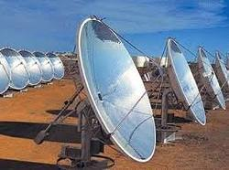
Solar Concentrators

Slide 46
Relevant Factors
 | MOON | MARS
Location | Poles (PELs) | Equatorial
Volume | 36m x 36m x 3m | 20m x 20m x 3m
Design | Pancake-shaped | Quonset hut
Materials | Metals from regolith | Plastics from air
Shielding | Regolith covering | Regolith shielding
Plant / Harvest | By crew in greenhouse | By crew in greenhouse
Maintenance | By crew in greenhouse | By crew in greenhouse

Slide 47
Relevant Factors
 | MOON | MARS
Lighting | Concentrated sunlight | Concentrated sunlight
Power source | Sun via concentrators | Sun via concentrators
Sunlight | 90% of day = 1,240 W | 50% - 15% = 250 W
Conversion losses | 0% | 0%
Plant configuration | 3D | 3D
Substrate | Hydroponic | Hydroponic

Slide 48
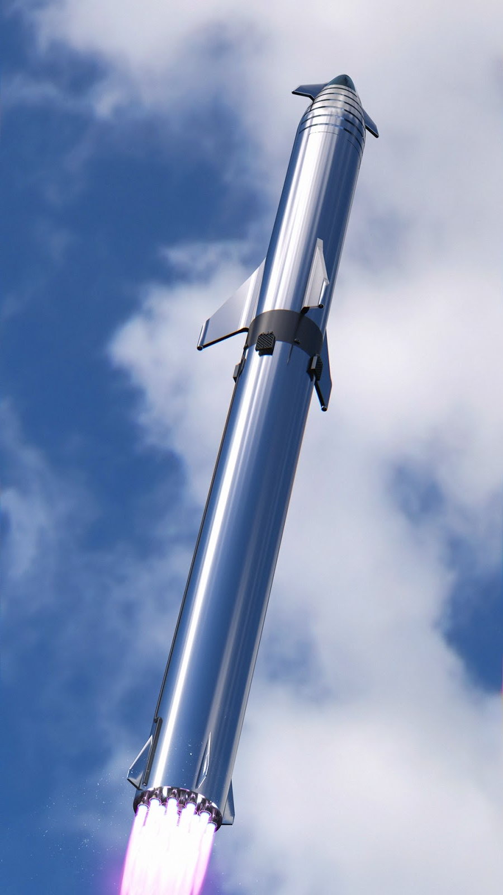

Slide 49
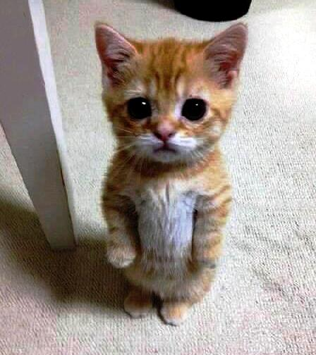
Thank you for your attention
DOUG PLATA MD, MPH
Space Development Network
DevelopSpace.info
Notes:
49

