Slide 1
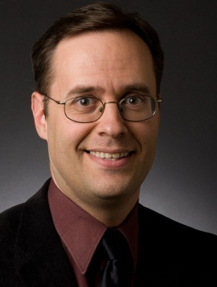
The International Lunar Exploration Phase
DOUG PLATA MD, MPH
Space Development Network
DevelopSpace.info
DougSpace007@gmail.com
909-557-7483

Slide 2
Overview
Notes:
2

Slide 3
Overview
Review of phases & funding
Scenario of the Initial Crew
The ILEP
ILEP economics ILEP – American Phase
ILEP – International Phase
l
l
l
l
l
l
Notes:
3

Slide 4
Overview
Growth of the international base Setting the stage for settlement Comparing transport architectures
Concluding comments
l
l
l
l
Notes:
4

Slide 5
Review of Phases
Notes:
5

Slide 6
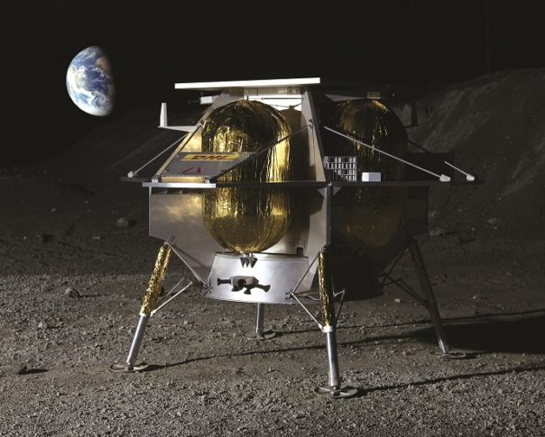
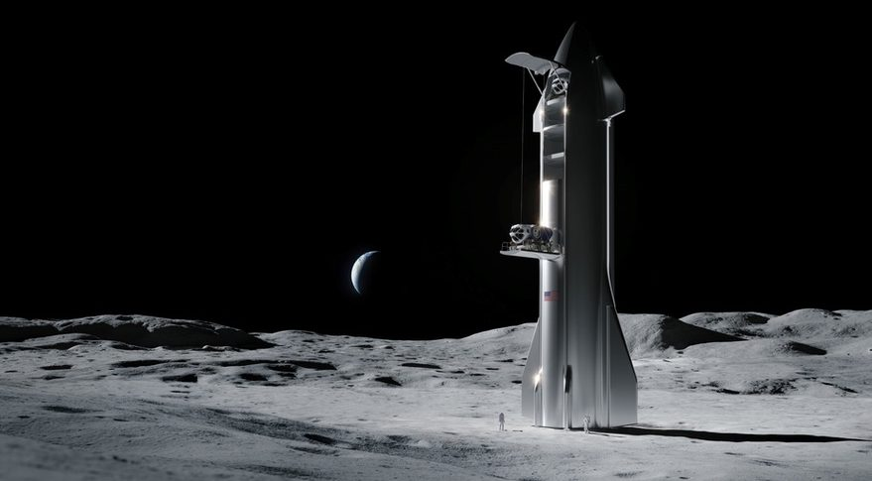
0 – Prospecting (Science & Demos)?
1 – Cargo Phase (incl. propellant)
2 – Initial Crew Phase

Slide 7
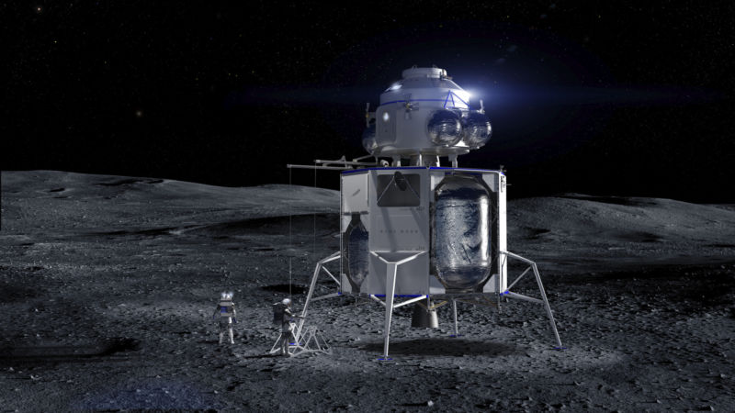
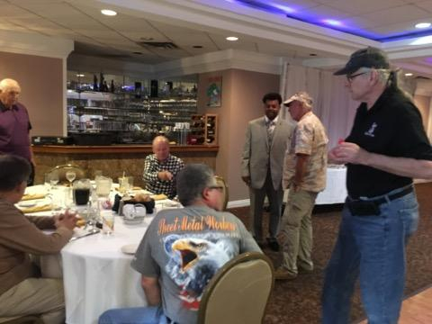
3 – International Exploration Phase
4 – Private Settlement Phase

Slide 8
0 – Prospecting & Demo Phase

Slide 9
1 – Cargo (incl. propellant production)

Slide 10
2 – Initial Crew

Slide 11
International Lunar Exploration Phase
Notes:
11

Slide 12
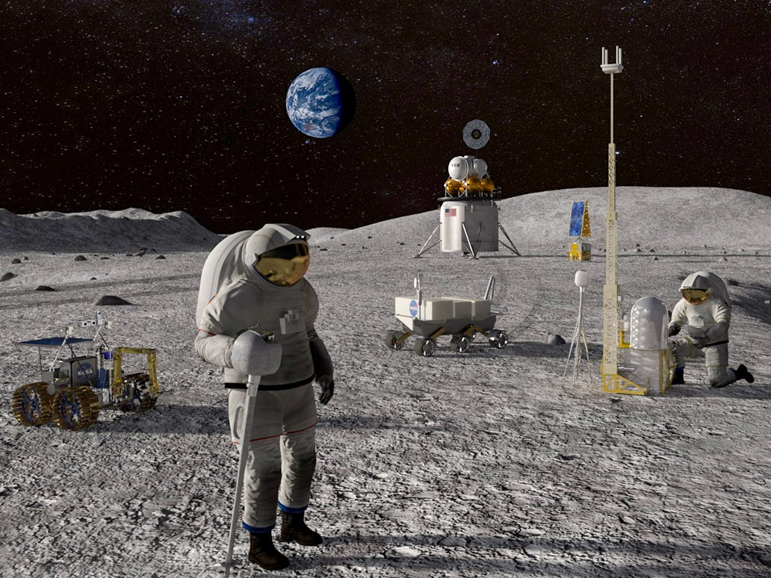
3a – ILEP - American

Slide 13
3b – ILEP – Other Countries

Slide 14
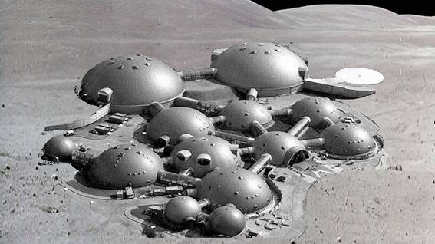
3b – ILEP – Other Countries

Slide 15
4a – Private Settlement (early)

Slide 16
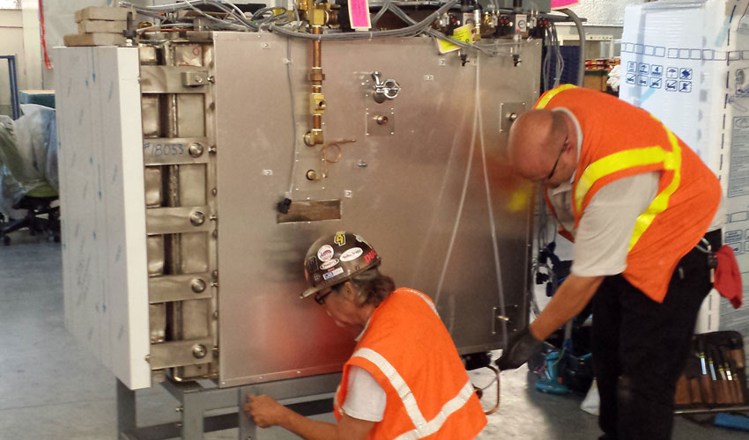
4a – Private Settlement (early)

Slide 17
4b – Private Settlement (later)

Slide 18
4b – Private Settlement (later)

Slide 19
ILEP - American
Notes:
19

Slide 20
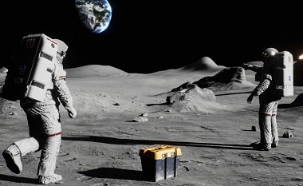
ILEP - American

Slide 21
ILEP - Economics
Notes:
21

Slide 22
DevelopSpace.info/gdp
0.1% of GDP 0.1% of GDP x 4 yrs

Slide 23
DevelopSpace.info/gdp
0.1% of GDP 0.1% of GDP x 4 yrs
195 nations

Slide 24
DevelopSpace.info/gdp
0.1% of GDP 0.1% of GDP x 4 yrs

Slide 25
DevelopSpace.info/gdp
0.1% of GDP 0.1% of GDP x 4 yrs

Slide 26
DevelopSpace.info/gdp
20%
80%

Slide 27
DevelopSpace.info/gdp
20%
80%
100%

Slide 28
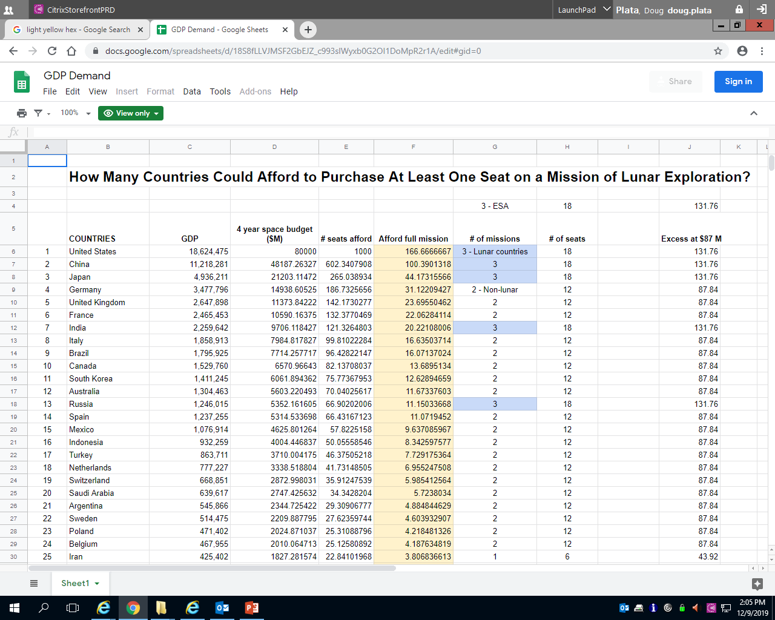
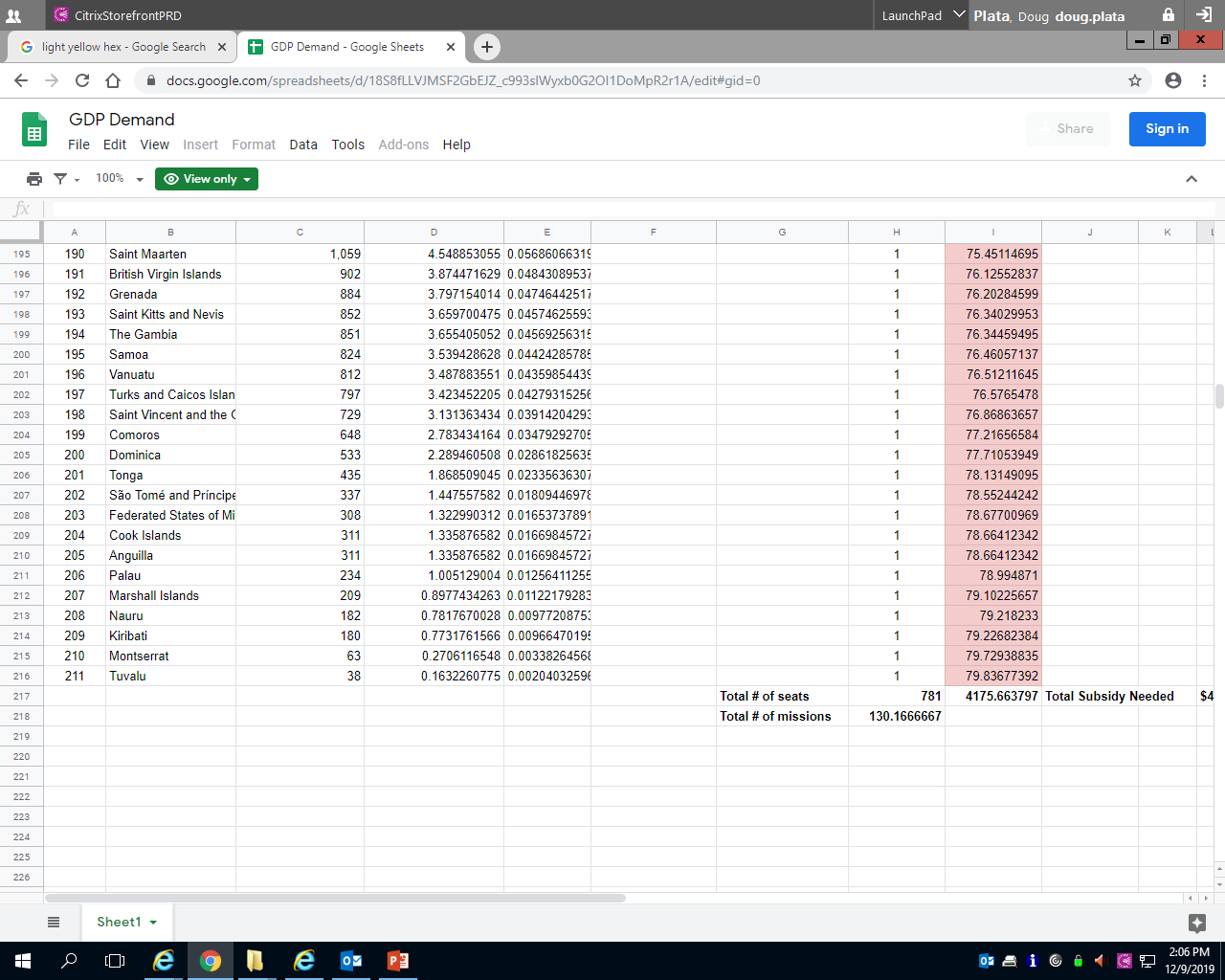
DevelopSpace.info/gdp

Slide 29
130 missions
Notes:
29

Slide 30
?
130 missions
??? interesting missions?
Notes:
30

Slide 31
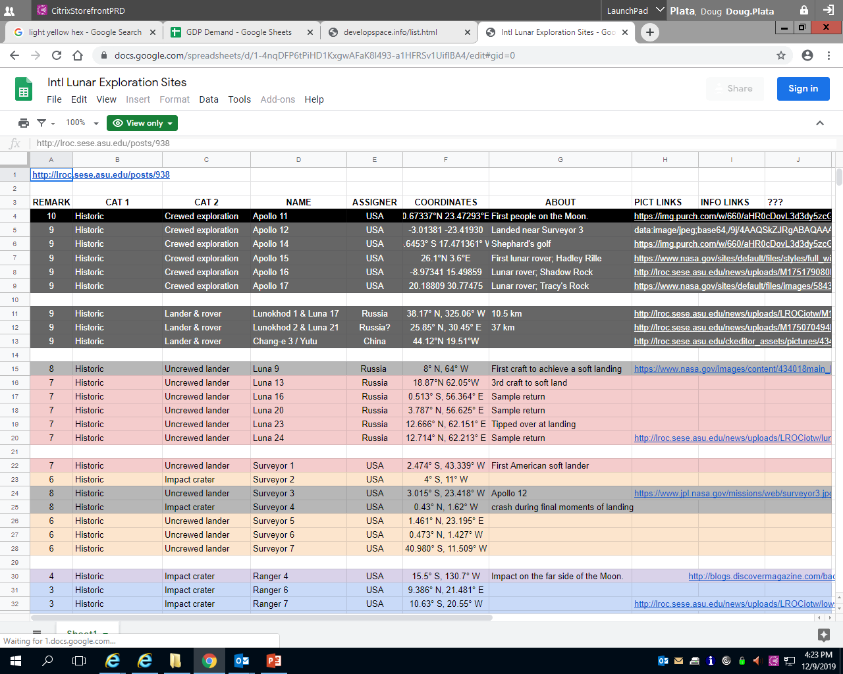
DevelopSpace.info/sitelist

Slide 32
?
130 missions
??? interesting missions?
Notes:
32

Slide 33
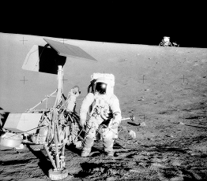
130 missions
160 interesting missions
Notes:
33

Slide 34
ILEP - International
Notes:
34

Slide 35
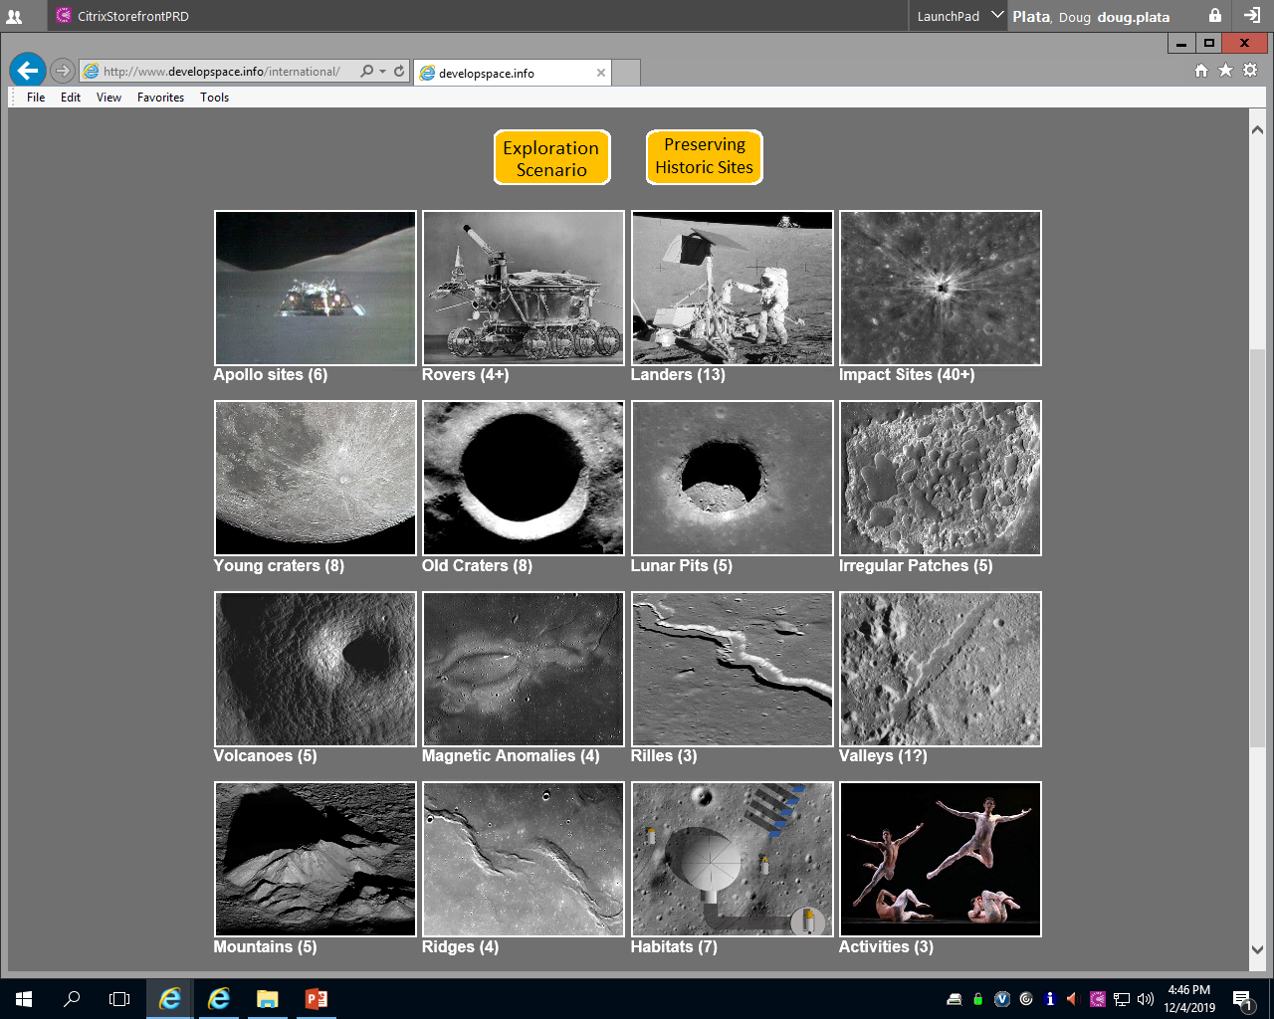
DevelopSpace.info/international

Slide 36
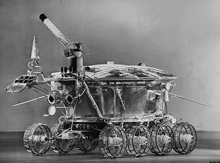
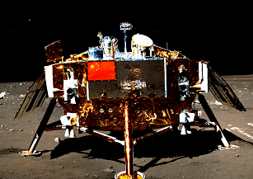
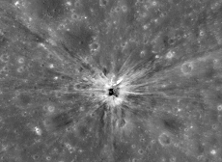
DevelopSpace.info/international

Slide 37
DevelopSpace.info/international

Slide 38
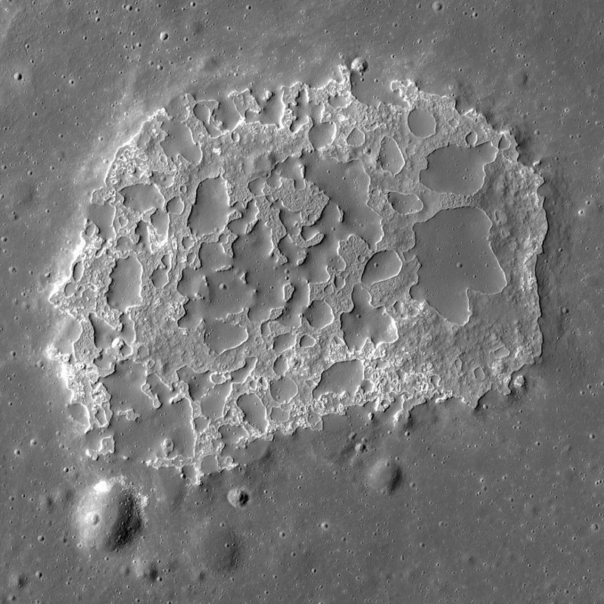
DevelopSpace.info/international

Slide 39
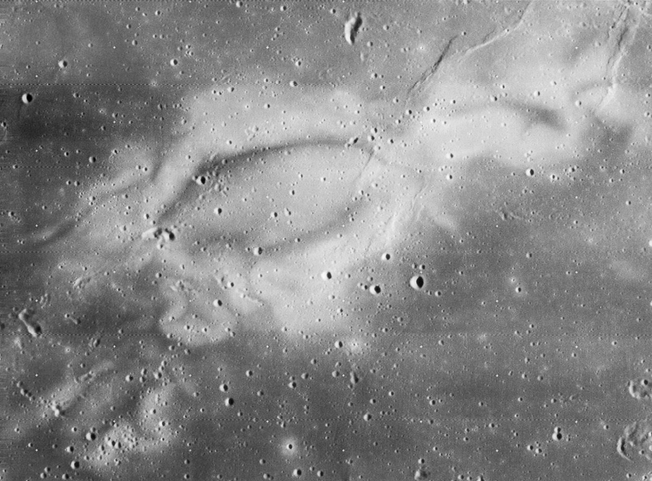
DevelopSpace.info/international

Slide 40
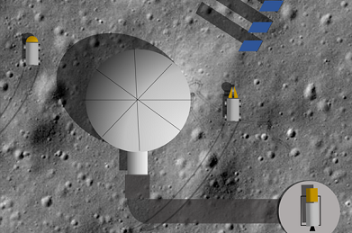
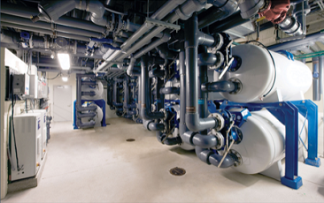
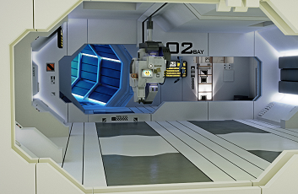
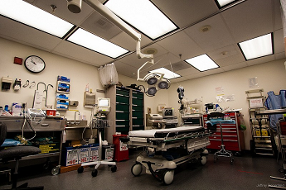
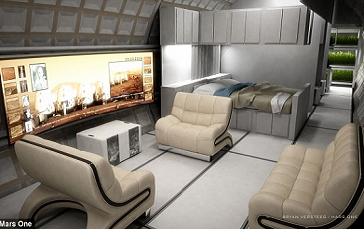
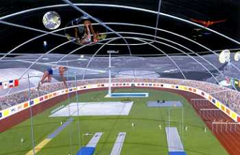
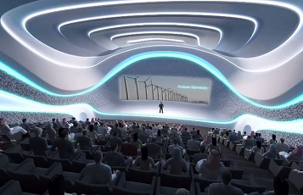
DevelopSpace.info/international

Slide 41
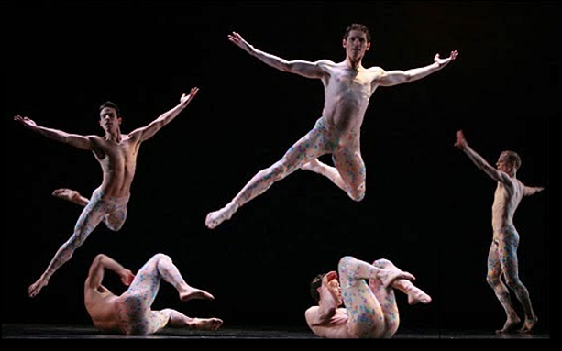
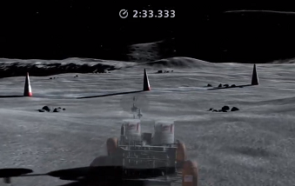
DevelopSpace.info/international

Slide 42
Expanding Base
Notes:
42

Slide 43
Expanding Base

Slide 44
Specialty Habs
MetalHab
MachineHab
AssemblyHab
SupportHab
GardenHab
SaniHab
DormHab
FarmHab
OrchardHab
BarnHab
KitchenHab
CafeHab
RestaurantHab
WelcomeHab
SpinHab
ClinicHab
SurgHab
DentHab
PharmHab
HospitalHab
ICUHab
DeliveryHab
NurseryHab
FitnessHab
SportsHab
SwimHab
GolfHab
ArenaHab
ChurchHab
MeetHab
TheaterHab
SpaHab
CinemaHab
JungleHab
BeachHab
Hotel Lunar
Hilton Hotel
Trump Luna

Slide 45
Private Settlement
Notes:
45

Slide 46
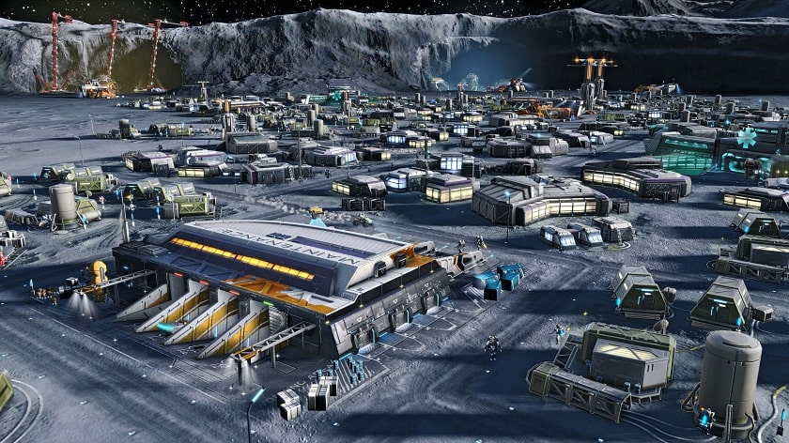
Private Settlement
ILEP
Private Settlement

Slide 47
Private Settlement
Early Later

Slide 48
Comparing Architectures
Notes:
48

Slide 49
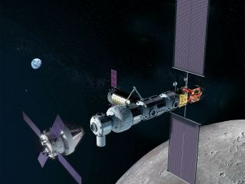
Comparing Architectures
SLS-Orion-
End-to-end
Gateway
Commercial

Slide 50
Comparing Architectures
$$$$$
$

Slide 51
Summary of Value
Notes:
51

Slide 52
Summary of Value

Slide 53
Summary of Value
Continuing American leadership.
l

Slide 54
Summary of Value
Continuing American leadership.
Greatly increasing the number
of partner countries.
l
l

Slide 55
Summary of Value
Continuing American leadership.
Greatly increasing the number
of partner countries.
Transitioning to truly commercial lunar development / settlement.
l
l
l

Slide 56
Summary of Value
Continuing American leadership.
Greatly increasing the number
of partner countries.
Transitioning to truly commercial lunar development / settlement.
Ensuring humanity’s survival.
l
l
l
l

Slide 57
Thank you for your attention
DOUG PLATA MD, MPH
Space Development Network
DevelopSpace.info
Notes:
57

